Slide 1
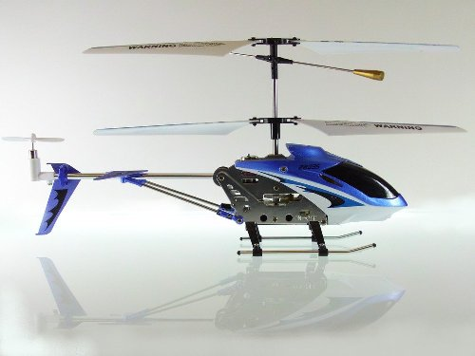
Voice Controlled Helicopter
Team Members: Jonathan Lam, Mian Zhu

Slide 2
Contents
Functionality
Design
Components in FPGA
Test Plan
Code Example
Additional Features
Sources

Slide 3
Functionality
IO Circuit should capable of controlling the helicopter via the onboard controllers and signals from FPGA.
FPGA should be capable of recognizing voice commands from microphone and determining whether or not those commands are valid by comparing them to a list of pre-stored commands on FPGA.

Slide 4
Additional Features
Inserting a sdcard that contains pre-programmed flight patterns to the Altera DE2 will allow users to see the helicopter fly different flight patterns.
Having the helicopter drop a payload on a pressure scale while it is in motion. The pressure scale will then output digital signals to an attached speaker.

Slide 5
Test Plan
Test | Results
Functionality of Controllers on IO Circuit | Helicopter is responding to the controllers on the IO Circuit. Wave functions on oscilloscope are appearing as expected with the a voltage range of 2.8-4.4V (3.6V at initial state)
Functionality of DACs (to be tested) | Ideal Results: A digital input to one of the DACs will output an analog current to the infrared controller.
Functionality of Audio Recognition by FPGA (to be tested) | Ideal Results: FPGA will recognize voice commands from Mic and will determine whether or not they are valid commands.

Slide 6
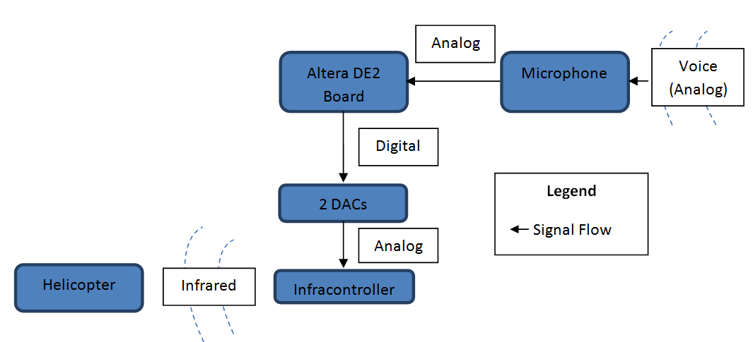
Design
Hardware Block Diagram:

Slide 7
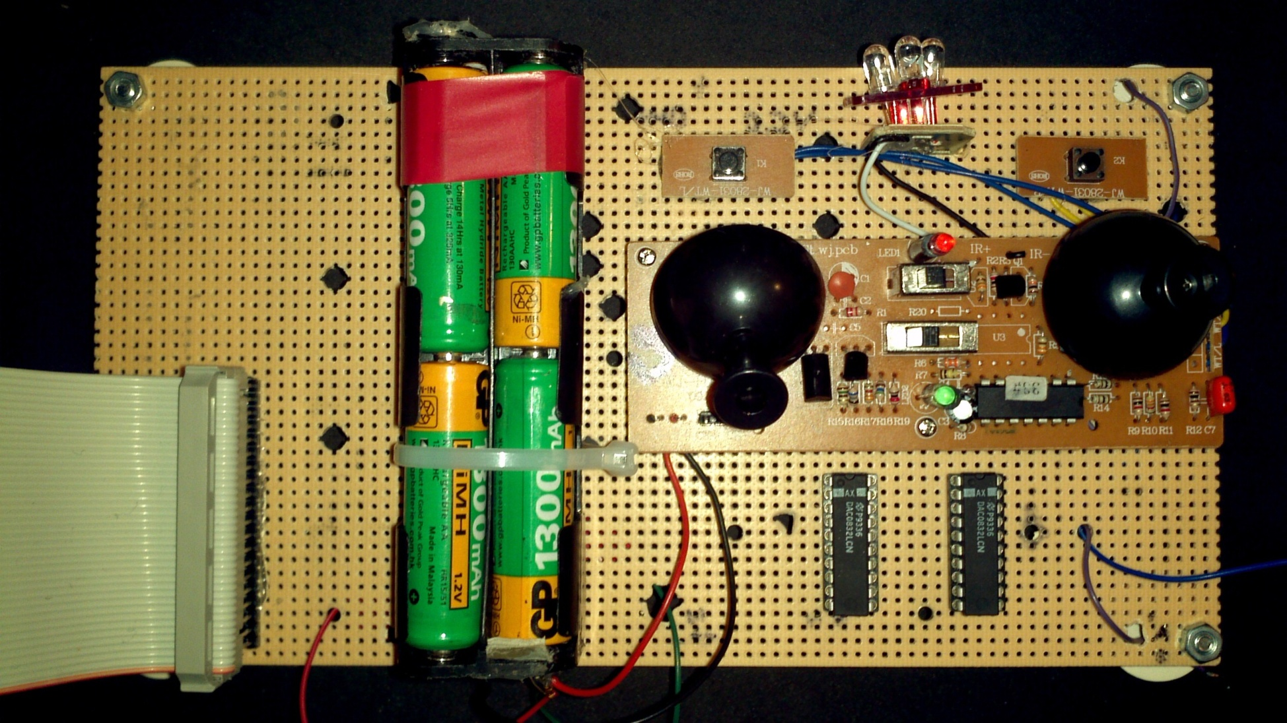
Design Cont’d

Slide 8
Design Cont’d
Organization of Software:
VHDL:
Top Level
Voice Input Analog Current Output
microC:
Training Recognizing

Slide 9
Design Cont’d
Biggest Challenge Thus Far:
Mimic controllers on IO Circuit
Pre-storing voice commands on FPGA
Getting FPGA to recognize the following voice commands: Up, Down, Left, Right, Forward

Slide 10
Speech Recognition
Training:
  Input several versions of a sound.
  Translate them to frequency domain by using the FFT (with the Altera IP MegaCore FFT module on the DE2 board).
  Average their amplitude in the frequency domain.
This produces the sound’s fingerprint.

Slide 11
Speech Recognition Cont’d
Recognizing:
  Input a sound sample.
  Translate it to frequency domain by using the FFT.
  Compared to the reference fingerprint by computing the Euclidean distance between them (as if both fingerprints where vectors).

Slide 12
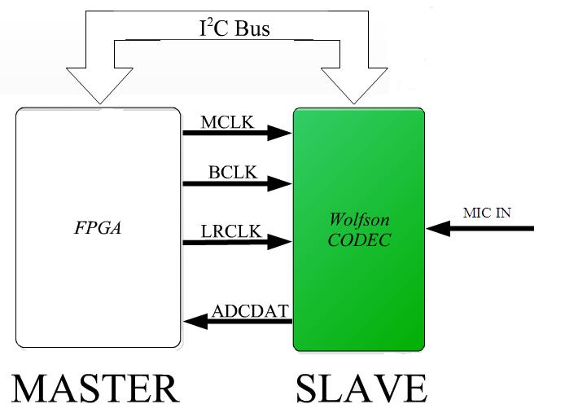
Components in FPGA

Slide 13
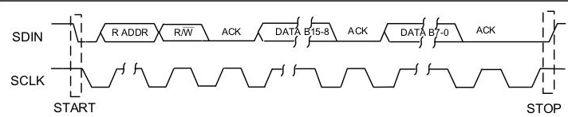
I²C Interface
I²C Interface Data Transimission

Slide 14
Code Example
CASE state IS
WHEN x"00" => -- Idle
-- when idle, both SDA and SCL = 1
SCL <= '1'; -- SCL = 1
SDA01 <= '1'; -- SDA = 1
RegisterAddressOut <= RegisterAddress;
DataOut <= "00000000";
state <= x"01";
----------------------------------------------------------------
-- send start condition and slave address
WHEN x"01" => -- Start
SCL <= '1'; -- SCL stays at 1 while
SDA01 <= '0'; -- SDA changes from 1 to 0
bitcount <= 7; -- starting bit count
state <= x"02";

Slide 15
Code Example Cont’d
-- send 7-bit slave address followed by R/W' bit, MSB first
WHEN x"02" =>
SCL <= '0';
SDA01 <= SlaveAddress_Write(bitcount);
state <= x"03";
WHEN x"03" =>
SCL <= '1';
IF (bitcount - 1) >= 0 THEN
bitcount <= bitcount - 1;
state <= x"02";
ELSE
bitcount <= 7;
state <= x"12";
END IF;

Slide 16
Sources
“EuroAirToys”. Internet: http://search.babylon.com/imageres.php?iu=http://www.euroairtoys.com/Helicopters/SX28035_BLUE/28035_sv_500.JPG&ir=http://www.euroairtoys.com/Index_menu_Helicopters.html&ig=http://t2.gstatic.com/images?q=tbn:ANd9GcThIAhPohcVyJ9ekC8xGajmTVwX6sqRgcLWtKj8crMvTIyyXQKVDGQIklE&h=375&w=500&q=28035 helicopter&babsrc=HP_ss
[Feb. 12, 2012].
“ A Simple Speech Recognition Algorithm for ECE341” by Tor M. Aamodt. Internet. http://www.eecg.toronto.edu/~aamodt/ece341/speech-recognition/
[Feb. 14, 2012]
“ I2C Master Controller” by Enoch Hwang. Internet:
http://faculty.lasierra.edu/~ehwang/digitaldesign/webpages/projects.html
[Feb. 14, 2012]

Slide 17
Thank You!

