Slide 1
UAV Imaging
g6: Shen Yue, Yushi Wang, Yubing Xu

Slide 2
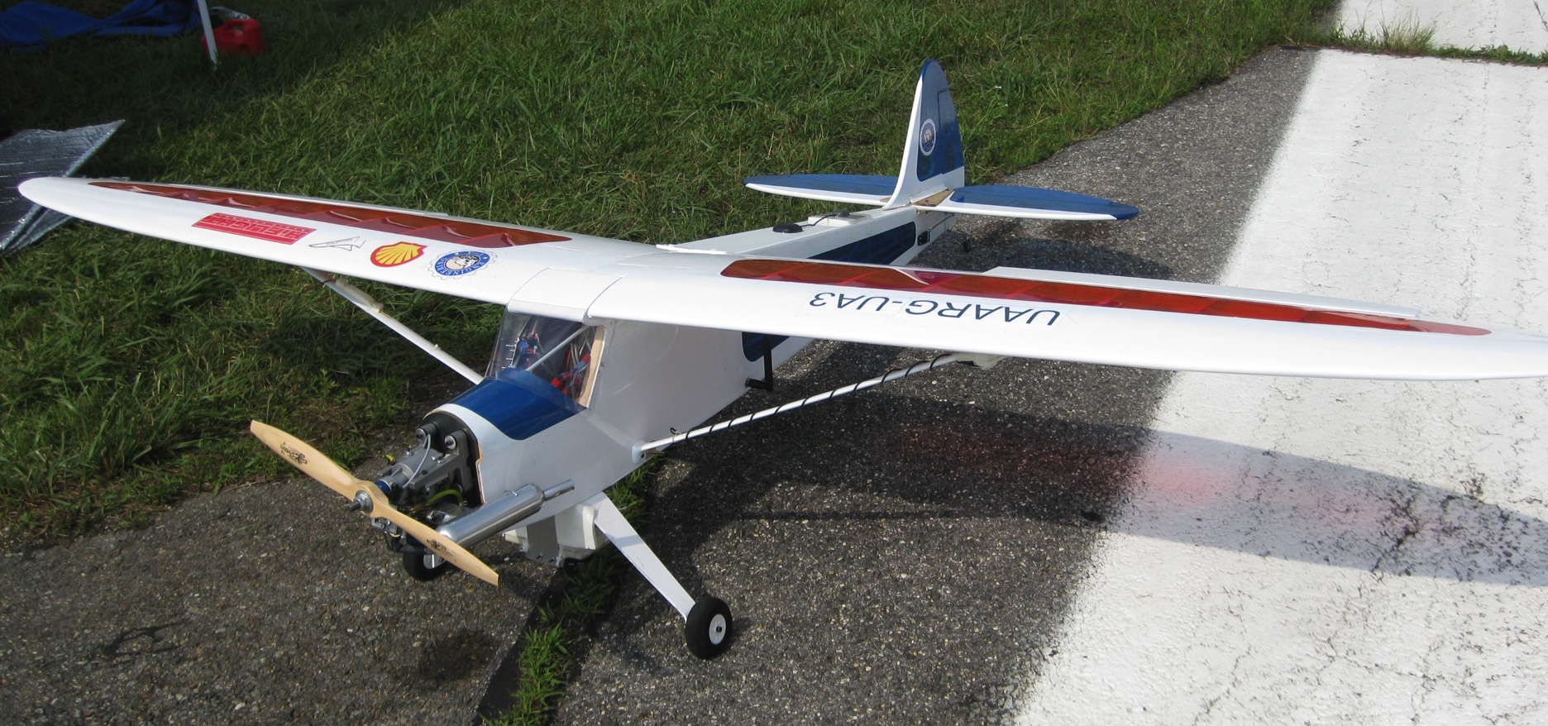
Introduction
Photo from UAARG 2009 Competition
Notes:
introduce group members and any parts of the project each has lead

Slide 3
Functionality & Motivation
Getting Photos
Identifying the markers
Analysis of the marker
Reducing resolution of the image
Sending image back with marker information

Slide 4
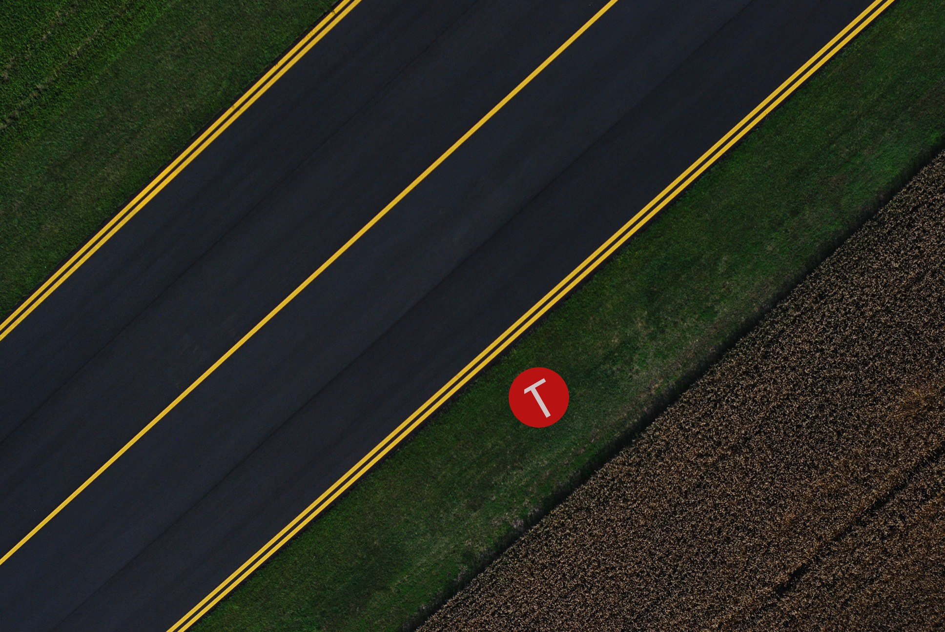
Picture of Marker
Photo from UAARG 2009 Competition

Slide 5
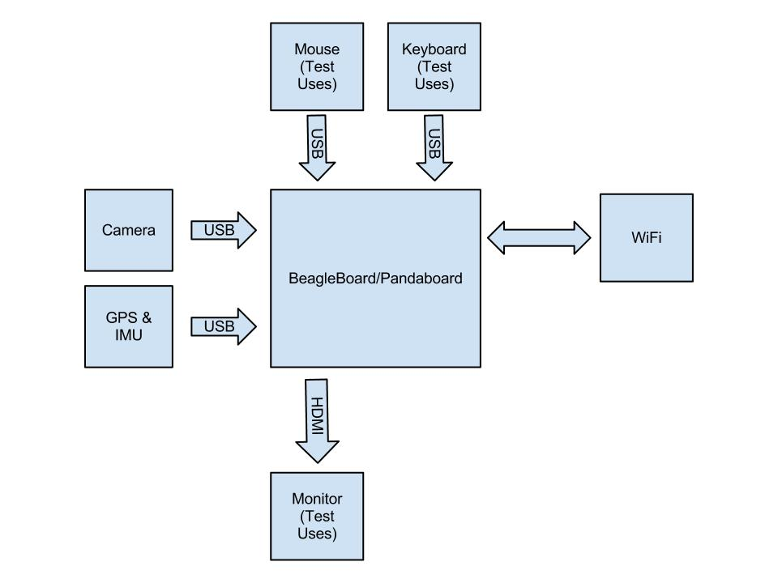
Hardware Block Diagram

Slide 6
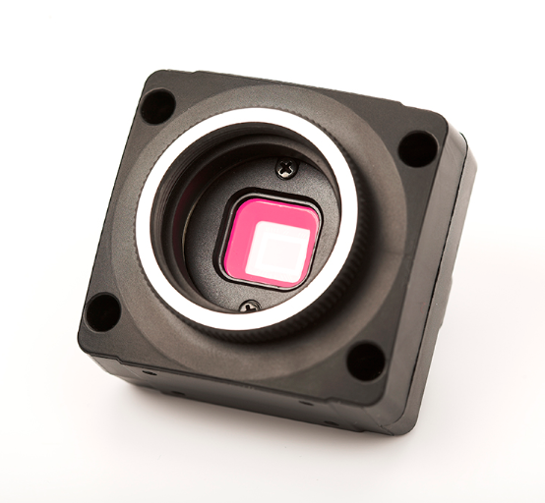
Hardware
1296(H)*964(V)
Image from Chameleon website: http://www.ptgrey.com/products/chameleon/images/Chameleon_1024px.jpg

Slide 7
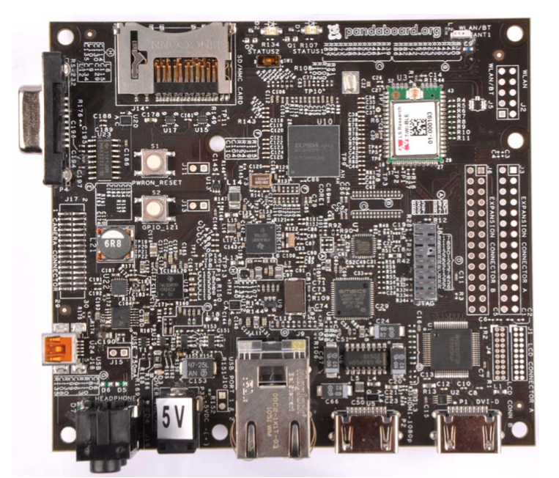
Hardware
OMAP4460 processor
Elpida 8Gb LPDDR2
Image from PandaBoard User Refference

Slide 8
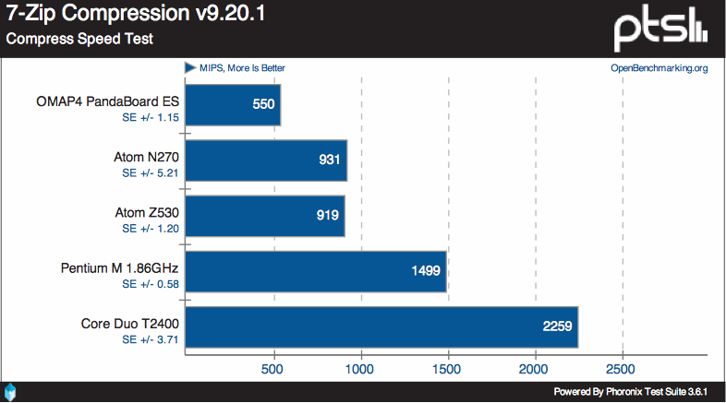
Performance
Graph from http://www.phoronix.com/scan.php?page=article&item=pandaboard_es&num=5

Slide 9
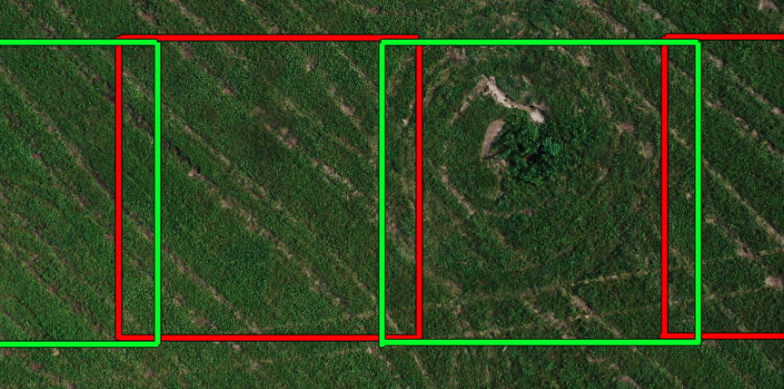
Minimum FPS = 2

Slide 10
500 ms Per Frame
Shape recognition from OpenCV library:
Laptop: 1s per frame
PandaBoard: 4s per frame

Slide 11
Strategy
Low cost filter
Identification
and
Recognition

Slide 12
Two-Stage Filter
Find high probability marker area
Refine the result

Slide 13
Find High Probability Area
Based on color consistency

Slide 14

Color Consistency
Marker
Grass

Slide 15
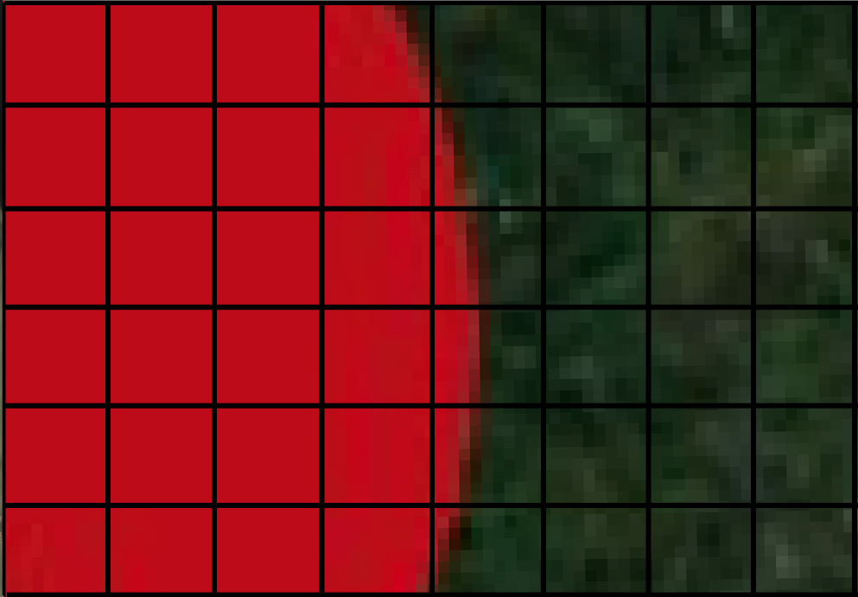
Take SDV of Slotted Image

Slide 16
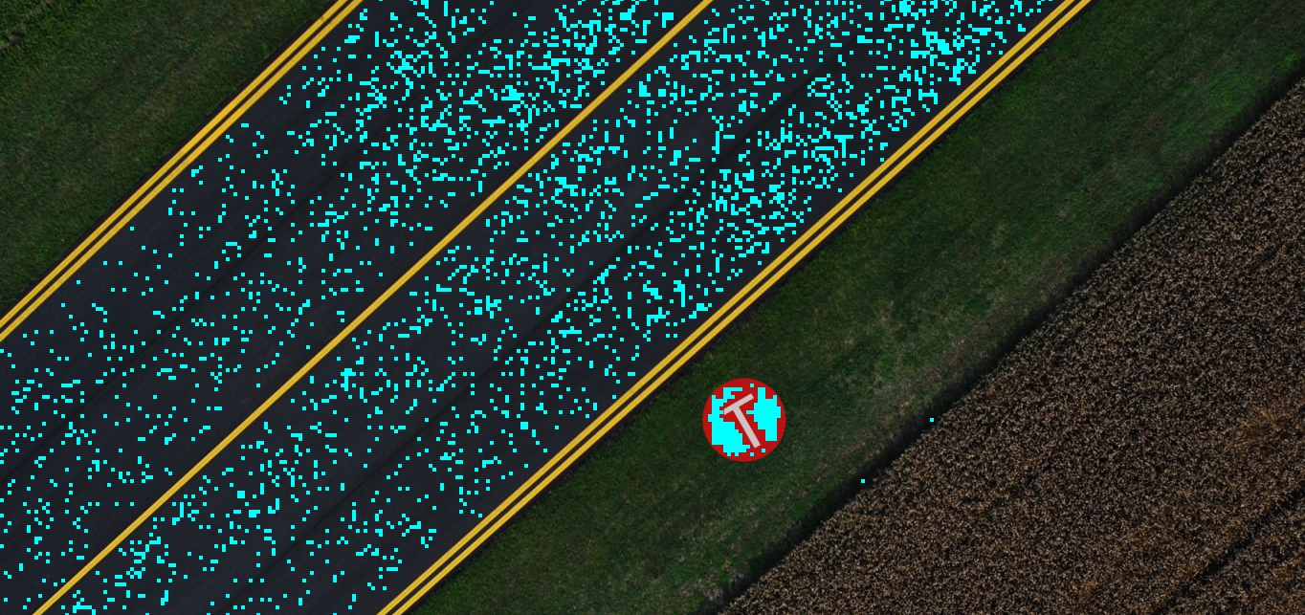
Thresholding

Slide 17
Two-Stage Filter
Find high probability marker area
Refine the result

Slide 18
Refining result
Connect high probability area and near by area with same color
Eliminate area with wrong dimensions

Slide 19
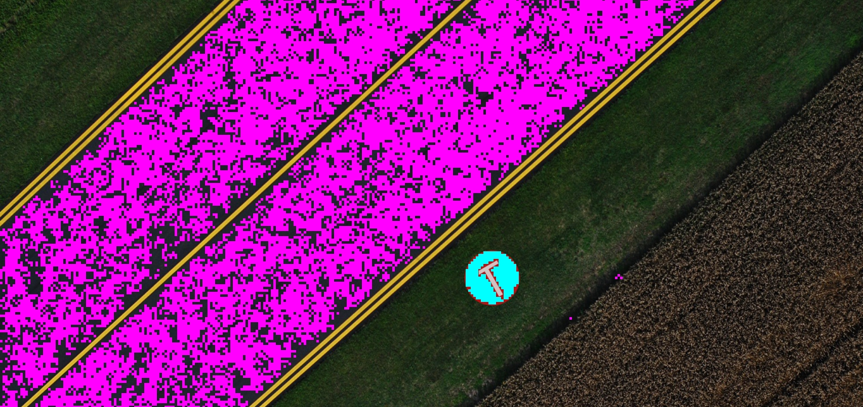
Result

Slide 20
Strategy
Low cost filter
Identification
and
Recognition

Slide 21
Identification and Recognition
Under research
Template matching

Slide 22
Software vs. FPGA vs. ASIC
 | Design Time | Performance
Software | Fast | Slow | Worst | Best
FPGA
ASIC
Notes:
The main purpose of hardware implementation is to compare the performance.

Slide 23
Components Implemented in FPGA
Marker Identification
  Marker Locating
    Filtering out most grass
Notes:
Benchmark this part - how long it takes and make comparisons
If small memory is accessed, then accessing memory on FPGA and it will be quick
FPGA HW vs. ARM SW benchmarks would be interesting

Slide 24
Code Example
void segmentBoundary(int x,int y,int *minX,int *maxX,int *minY,int *maxY,TWO_D_INT_POINTER_ARRAY *filterResult,IplImage* smallImageHSV,int smallWidth,int smallHeight,int *numberForProcessing,int *markerAreaCount,int recursionDepth)
{
//Recursion depth protection
if(recursionDepth>MAX_RECURSION_DEPTH) return;
//Record range of the area
if (x<*minX) *minX=x;
else if(x>*maxX) *maxX=x;
if (y<*minY) *minY=y;
else if(y>*maxY) *maxY=y;
(*markerAreaCount)++;
filterResult->data[x][y]=numberForProcessing;

Slide 25
Code Example
int xDirection[8]={1,-1,0,0,1,1,-1,-1};
int yDirection[8]={0,0,1,-1,1,-1,1,-1};
for (int i=0; i<8; i++)
{
if (connected slot is a high probability slot || connected slot has similar color to the current slot)
{
segmentBoundary(x+xDirection[i],y+yDirection[i],minX,maxX,minY,maxY,filterResult,smallImageHSV,smallWidth,smallHeight,numberForProcessing,markerAreaCount,recursionDepth+1);
}
}
}

Slide 26
Test Plan
Software
Hardware
DE2
Notes:
JTAG debugging on DE2 to copy memory for the benefit of a hardware accelerator, without needing to write code for the Nios.

Slide 27
Software Testing
Use images from previous competition as input frames
Compare software generated result with expected result

Slide 28
Result for Filter stage
Total targets: 33
Targets found: 33
Other objects identified as target: 14
FPS on Laptop (non-optimized): 8

Slide 29
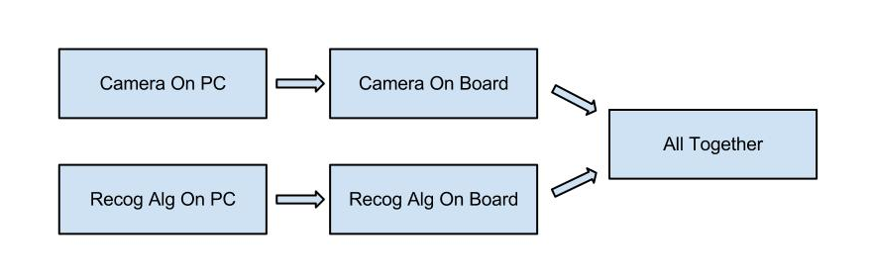
Hardware Testing

Slide 30
DE2 Testing
  JTAG debugging

Slide 31
Extra Features
Identifying Characters in Markers
Interpolating GPS and Obtain Direction Information
Providing a 9600 bps Tunnel Through the Processor and WiFi to Serial Port on Ground Station
Adapting Ground Station Software with the new way of operating
Notes:
Other features to add or previously described features to remove
Identifying characters in markers; interpolating GPS and obtain direction information; providing a 9600 bps tunnel through the processor and WiFi to serial port on ground station; adapting ground station software for your new way of operating.

Slide 32
Questions?

Slide 33
Thank You

