Slide 1
CMPE 490
Presentation
Video Game
Group members:
Billy Kozak
Nathan Sinnamon
Jeff Theriault

Slide 2
Motivation
We wanted to make a better video game than ‘Lunar Lander’
To do something we will enjoy working on
Testing = playing video games (at least in the (very, very) late stages)
The end product is fun!

Slide 3
Functionality
Gameplay which emulates an arcade-style space shooter
Wireless controllers which use accelerometers as input
Multiplayer! (by ‘multi’ we mean 2)
Video (VGA) output

Slide 4
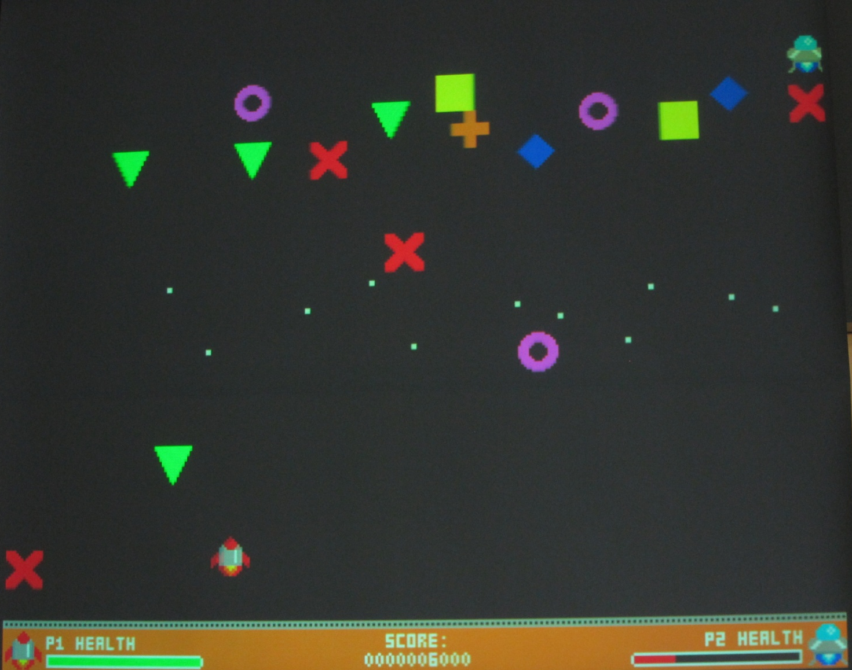
Game Concept

Slide 5
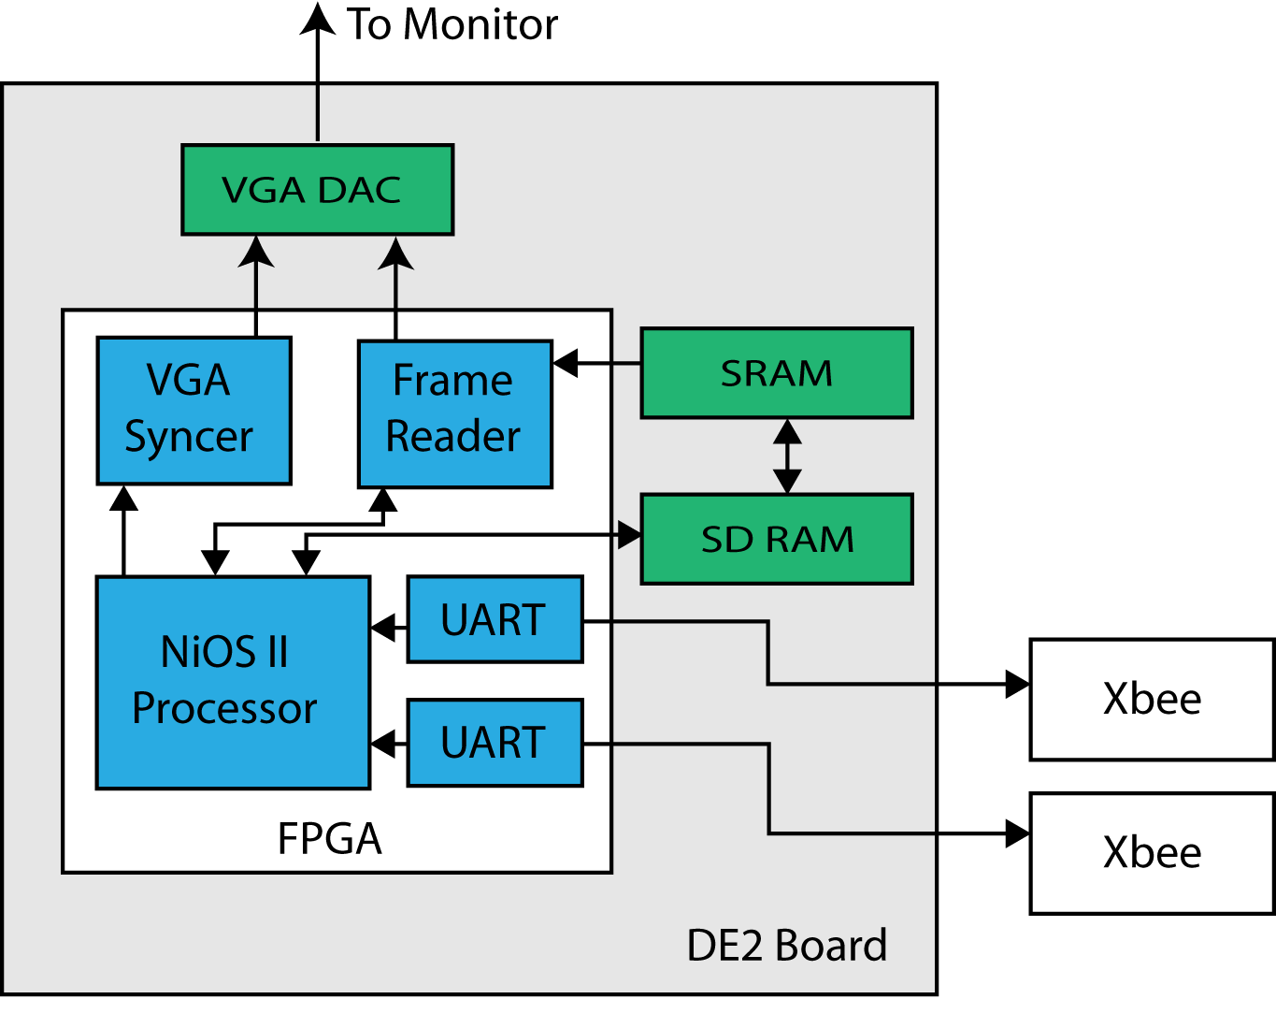
Design:
Main Unit

Slide 6
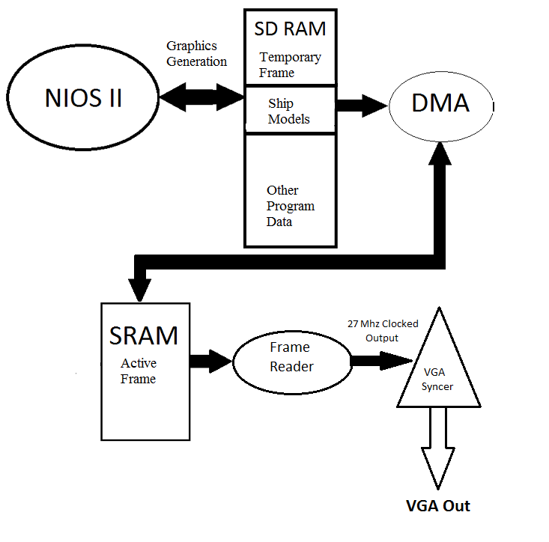
VGA Buffer System

Slide 7
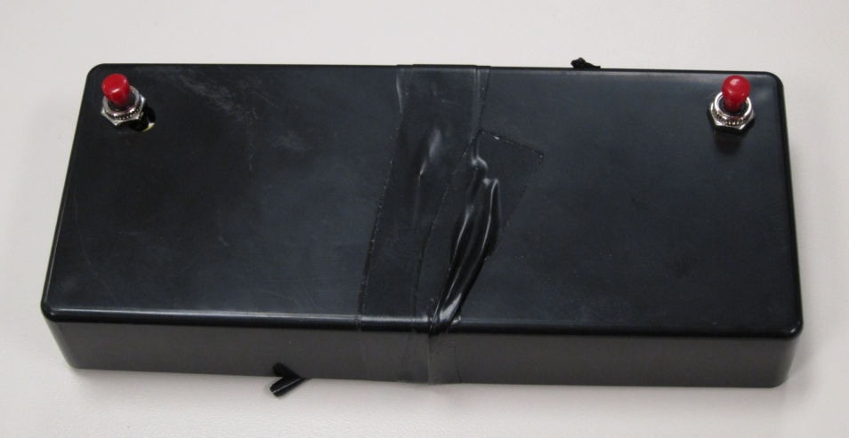
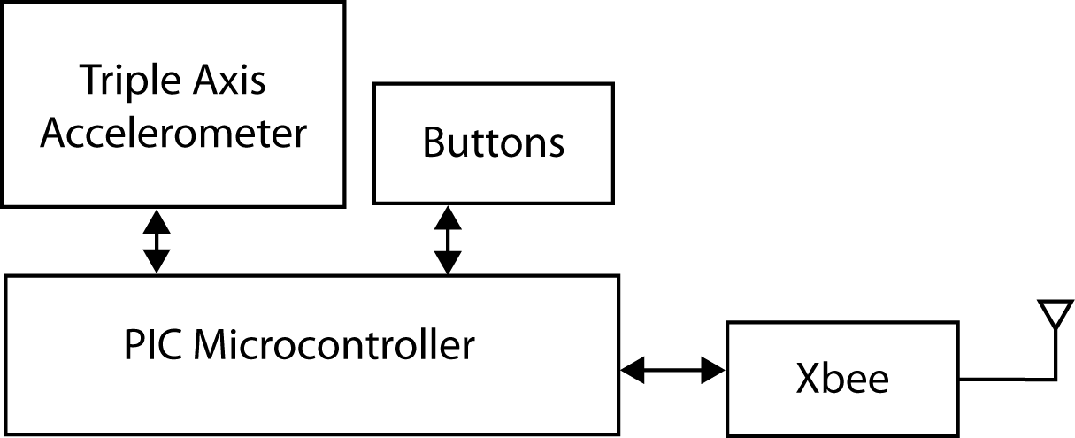
Design:
Controller
Triple Axis Accelerometer
  Detect controller rotation and gestures (Wii-style)
PIC Microcontroller on-board
  Processes accelerometer (I²C) data
  Formats current state into a packet and transmits via Xbee to Main unit
ZigBee wireless communication
  Cables are bad. Wireless is fun!
  PIC communicates with ZigBee over a serial link

Slide 8
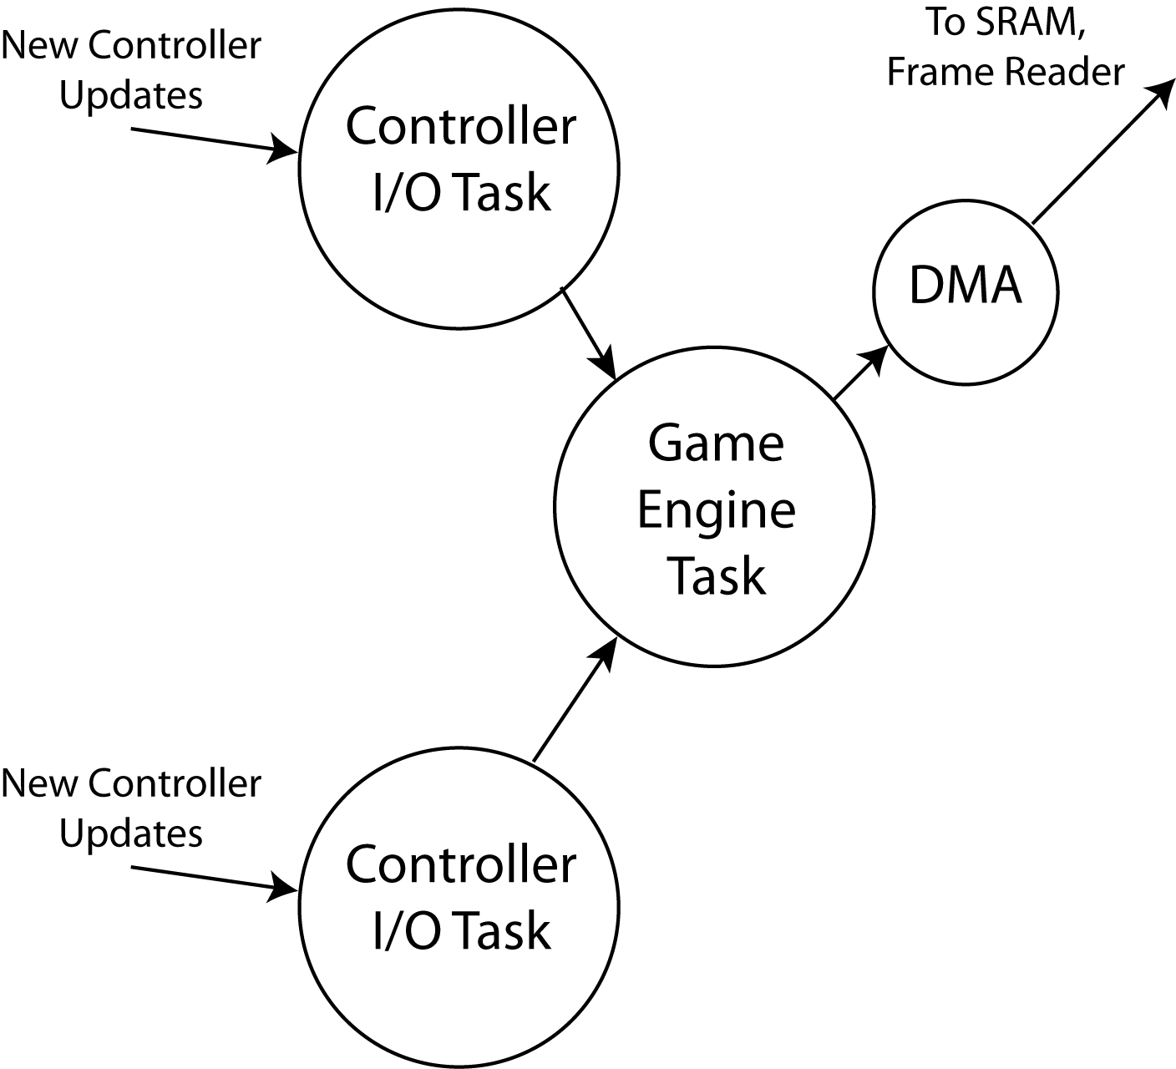
Design:
Software

Slide 9
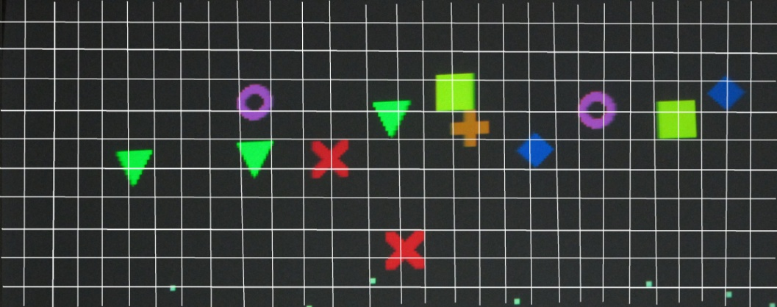
Design:
Game Engine
The game engine works by repeating 8 basic steps in a continuous loop.
Step 1 fetches new ships from memory and places them onscreen if the correct amount of time has elapsed.
Step 2 reads data from the controllers and updates the player ship’s positions.
Step 3 updates locations of the enemy ships as determined by simple AI routines.
Step 4 updates the locations of all onscreen projectiles
Step 5 detect collisions and resolve collisions (between two or more ships or a ship and a projectile)
Step 6 redraws every ship and projectile according to its updated position (dead ships/ projectiles are erased)
Step 7 detect for victory or loss conditions so we can
Step 8 update the game’s time counter and ensure that we don’t go back to step 1 until 15ms have passed

Slide 10
Conclusion
Video games are harder to make than we thought!
The benefits (and sheer terror) of “writing it yourself”

Slide 11
Questions?

