Slide 1
CMPE 490
Critical Design Review
Presentation
Video Game
Group members:
Billy Kozak
Nathan Sinnamon
Jeff Theriault

Slide 2
Motivation
We want to make a better video game than ‘Lunar Lander’
Testing = playing video games (at least in the late stages)

Slide 3
Functionality
Arcade-style space shooter
Wireless controllers which use accelerometers as input
Multiplayer!
Video (VGA) and audio output

Slide 4
Concept

Slide 5
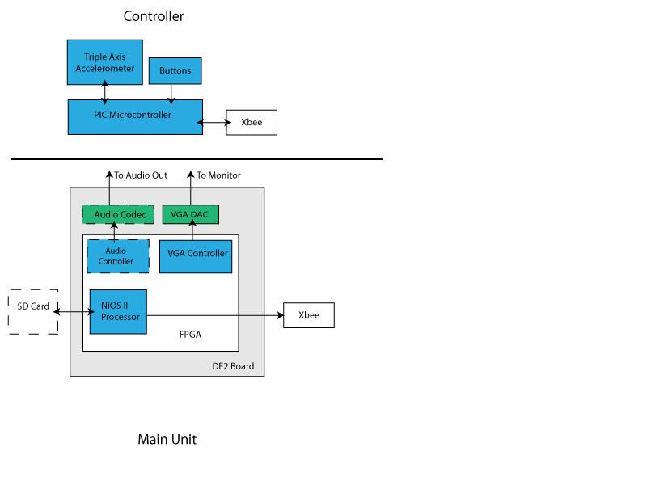
Design:
Hardware

Slide 6
Design:
Controller
Triple Axis Accelerometer
  Detect controller rotation and gestures (Wii-style)
PIC Microcontroller on-board
  Processes accelerometer (I²C) data, button debouncing, etc
  Formats current state into a packet and transmits via Xbee to Main unit
  Error detection in accelerometer
ZigBee wireless communication
  Cables are bad. Wireless is fun!
  PIC communicates with ZigBee over a serial link

Slide 7
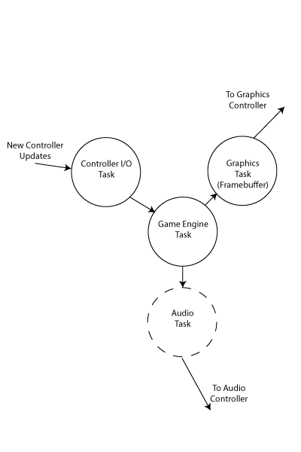
Design:
Software
Game Engine computes game state, graphics updates
Graphics Task maintains VGA output based on current Game Engine State
Controller Task receives input from controllers, cleans it up, and hands it off to the Game Engine

Slide 8
Software Performance & Optimizations
Optimized core operations ~59ms ~ 17fps
(slower in reality)
w/ LUTs for trig & object graphics
30 objects on screen max
grid based collision detection
May need to look at sprite graphics to get better performance

Slide 9
Code
Excerpt
FILE *fp = fopen("/dev/uart_0", "r");
char line[MAX_LINE_LEN];
while( fgets( line, sizeof( line ), fp ) != NULL )
{
char playerNo;
char battLevel;
float xAccel;
float yAccel;
float zAccel;
char fireButton;
char startButton;
//Line got.
if( sscanf( line, "%d:%d:%f:%f:%f:%d:%d"), &playerNo, &battLevel, &xAccel,
&yAccel, &zAccel, &fireButton, &startButton) != 7 ) )
{
ControllerState *state = controllerStates[playerNo];
OSSemPend( ControllerLock, WAIT_FOREVER, &err );
state->battLevel = battLevel;
//convert to G's
xAccel = xAccel / ACCEL_SENSITIVITY;
yAccel = yAccel / ACCEL_SENSITIVITY;
zAccel = zAccel / ACCEL_SENSITIVITY;
//TODO: FP performance isn't great... Fix this.
//these angles will be used by the Game engine to compute velocity
//and direction of player ships.
state->roll = atan( yAccel / sqrt( zAccel * zAccel + zAccel * zAccel ) );
state->pitch = atan( xAccel / sqrt( yAccel * yAccel + zAccel * zAccel ) );
state->fireButton = fireButton;
state->startButton = startButton;
OSSemPost( ControllerLock ); //allow other bits to read the data.
}
}

Slide 10
Test Plan
Test-Driven Development (TDD)
Assemble VGA connections and test with hard-coded patterns from NIOSII (done)
Assemble controller hardware and test communication with the NIOSII
Test simple connecting software which bridges controller inputs and VGA outputs
Test game engine, ie., final system testing

Slide 11
Features
Addition/Expansion Options
Improve graphics/audio
Create a second game using existing H/W
Removal Options
Audio
“Wirelessness”
Replace scrolling background with static one

Slide 12
Questions?

