Slide 1
Intruder Alert System
By:
Jordan Tymburski
Rachita Bhatia

Slide 2
Motivation
An unmanned security system that will be able to detect intruders.
Could offer an easy connection to the internet for remote monitoring.
Target audience: personal home security or large scale business security

Slide 3
Functionality
Camera Detecion
Frame Snapshot
Screen
Video feed display
Motion Detection
Analysis
Image References (Accessed on February 13, 2012):
Camera http://www.spycamerassecurity.com/wp-content/uploads/2010/09/wireless-spy-camera.jpg
Motion Detection: http://www.codeproject.com/KB/audio-video/Motion_Detection.aspx
Screen: http://www.codefear.com/wp-content/content/linux-touch.jpg?ba4058

Slide 4
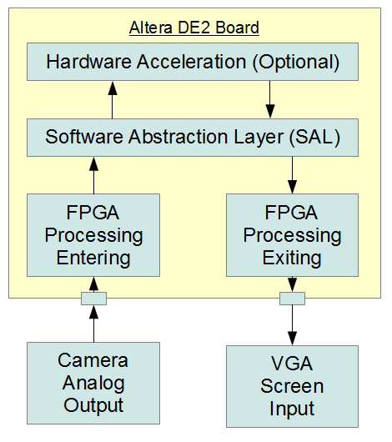
Hardware Overview
Security camera with composite output plugged into the Altera DE2
  Interfaces with the ADV7181B
VGA monitor plugged into the onboard VGA port.
  Interfaces with the ADV7123

Slide 5
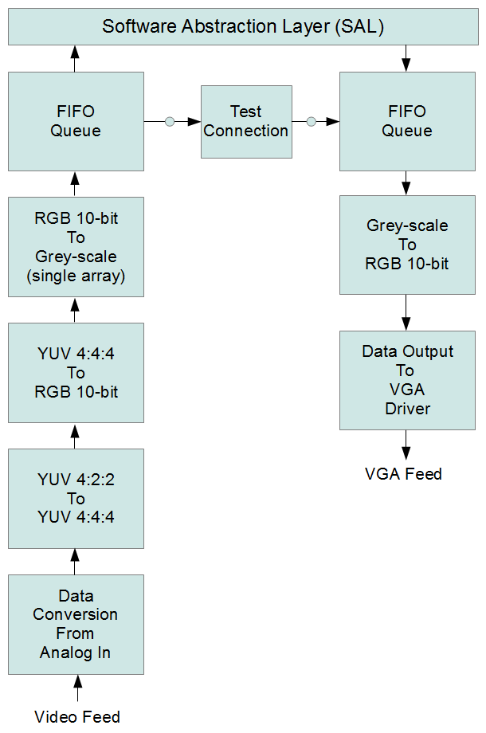
FPGA Hardware
Each block is an FPGA entity/architecture dual
Will all be instantiated from a top level VHDL file to handle the flow
Conversion from YUV (YCbCr) to RGB essential since VGA requires RGB

Slide 6
Software Design
Task A
Data Input from FIFO queue
Extract background and current frames
Task B
Compare frames
Outline moving subjects
Task C
Output Data to FIFO queue
Queue 2
Queue 1

Slide 7
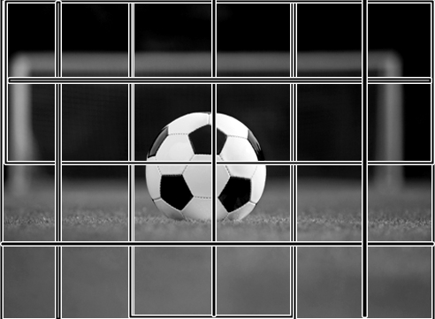
Motion Detection Algorithm
The image is broken into small rectangular boxes
The pixels of the current frame are compared to the background.
If they exceed the threshold value, then the box containing that pixel is are marked
Check if the marked boxes are adjacent to each other
  If yes, outline their non shared boundaries
  If not, outline all boundaries
Image Source: http://ssc.goalline.ca/news_images/org_1192/Image/soccer1.jpg
(February 13, 2012)

Slide 8
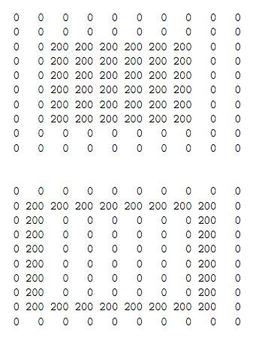
Pseudocode
// Comparing frames
compareFrames(background, current) {
…
error = isImagesEqual(background, current);
if(error > threshold)
box.outline(corners);
…
}
// Checking adjacent boxes
isAdjacent(box_1){
for(i = I to n){
if (box_1.coordinates = box_i.coordinates)
return true;
}
}
Image Source:
D. Phillips, Image Processing in C, 2nd Edition, R & D Publications, April 2000.
http://homepages.inf.ed.ac.uk/rbf/BOOKS/PHILLIPS/cips2ed.pdf
(Accessed February 13, 2012)

Slide 9
Challenges – Memory Management
Each image has a resolution of 640x480
A char represents each pixel, so we would need about 300 KB of memory per image
A total of 8 MB of memory is available
Accommodate as many images as possible in the amount of memory space we will have left

Slide 10
Testing
Initial unit testing split into two blocks, software and hardware:
  Software testing will be done with simulated graphics data
  Hardware will test by pushing the input video straight to the monitor
Integration testing will add feature by feature onto hardware from the software end.

Slide 11
Additional Features
Algorithm Improvements
Set up a web server
Video storage

Slide 12
Application Note
An app note on taking the composite video feed in and converting it to workable data.
Will only show the video coming out as RGB 8-bit from the FIFO
Hoping to have it out at the end of reading week.

Slide 13
Questions?

