Slide 1
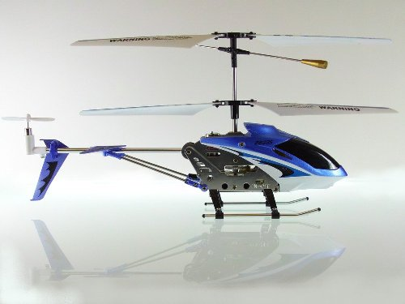
Voice Controlled Helicopter
Team Members: Jonathan Lam, Mian Zhu

Slide 2
Outline
Introduction
Software Implementation
IO Circuit Design
Photos of System
Demo Video
Live Demo

Slide 3
Introduction
Purpose:
Designing a system such that individuals could control a radio-controlled helicopter via voice commands.
Motivation:
Fun and Unique
Accomplishments:
Helicopter responds to certain voice commands
Helicopter moves Up and Down, as well as, Start and Land when such commands are spoken into the mic.

Slide 4
Software Design
Four modules: Main, Recognition, LCD, LEDs.
Read values from both channels and store them in buffers.
Once a word is completed, its information is sent to the recognition module
Infomation of the sound and the system is displayed through LCD, LEDs and seven segment displays.
System is controlled by the slide switches.
Safety control is implemented using the pushbuttons.
The sound values are fed back into the CoDec, then outputted through the line out.

Slide 5
Manual Control
SW0 controls the power to the system.
SW1 toggles between the two control mode.
3 pushbuttons added as safety control.
  KEY1 for incrementing the current speed of the helicopter
  KEY2 for decrementing the current speed of the helicopter
  KEY3 for emergency landing, which slowly reduces the helicopter’s speed
  The default reset button KEY0 will send a stop signal to the helicopter

Slide 6
Display
LEDs
  8 red LEDs for left channel
  8 green LEDs for right channel
  The LEDs shows the amplitude of the sound
LCD
  Display control mode and current speed
Seven Segments
  Display the current state of the program

Slide 7
Recognition Algorithm
We match the words based on 3 criteria
  Length of the word
  The maximum positive amplitude of the word
  The maximum negative amplitude of the word
The matching range of the 3 criteria is obtained through testing.
If 2 out of the 3 criteria fall in the matching range, we decide we have a match.

Slide 8
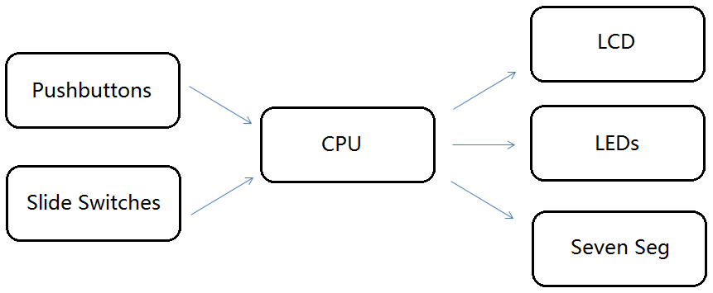
Software Diagram

Slide 9
Software Testing
Valid Commands | # Trials | # Success Match | Accuracy
UP | 10 | 9 | 90%
DOWN | 10 | 10 | 100%
START | 10 | 9 | 90%
LAND | 10 | 10 | 100%
Invalid Commands | # Trials | # False Match | Error Rate
LEFT | 10 | 0 | 0%
Right | 10 | 0 | 0%

Slide 10
Hardware Components
NpN Transistor (2N3691)
Microphone
Digital-to-Analog Converter (DAC0832LAN)
Helicopter
Op-Amp (LM324N)
Infrared Controller

Slide 11
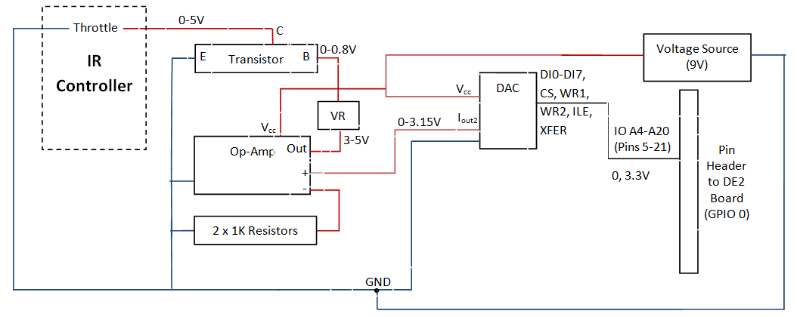
IO Circuit Schematic

Slide 12
IO Circuit Test Results
Mode of Operation | NpN Transistor Collector-Emitter Voltages (V)
Helicopter Motor ON | >3.5
Full Speed | 5.0
Helicopter Motor OFF | 0
32-bit Hex Address | NpN Transistor Collector-Emitter Voltages (V)
0x00013802 | 3.5
0x00013BD2 | 5.0
0x00011002 | 0

Slide 13
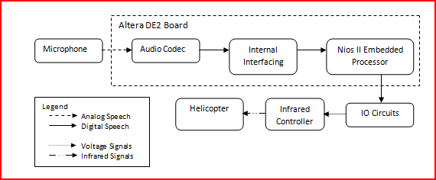
Block Diagram of Operation

Slide 14
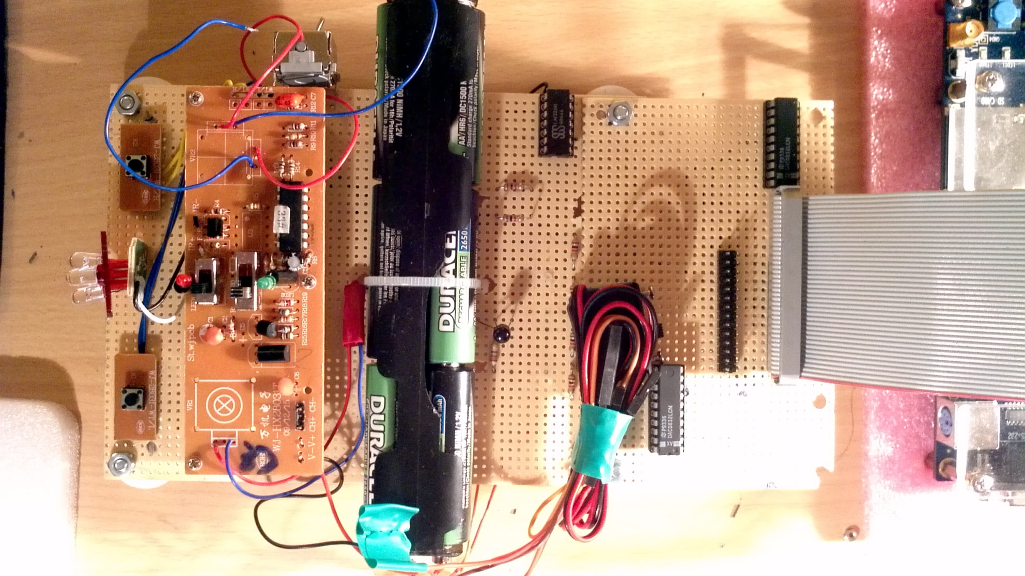
Photos of System

Slide 15
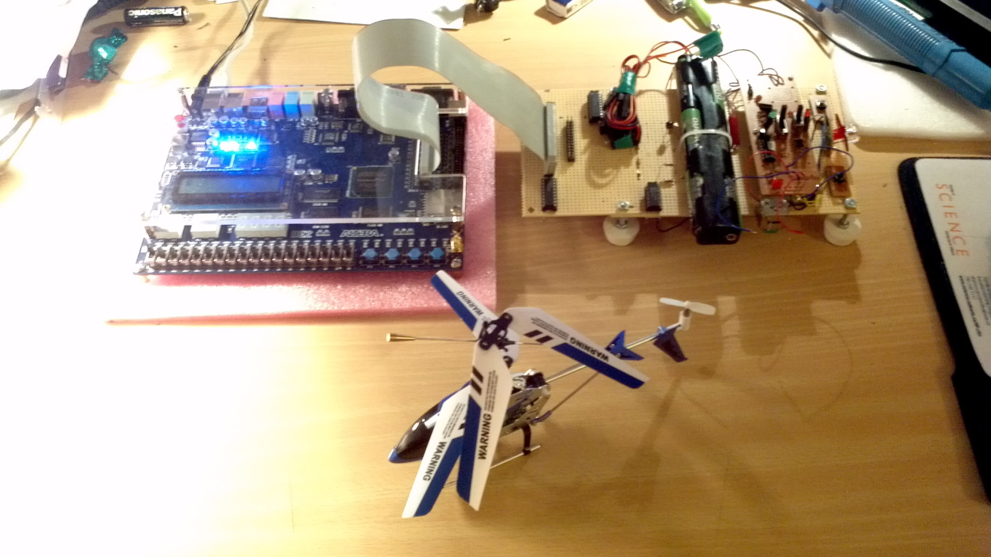
Photos of System Cont’d

Slide 16

Demo Video

Slide 17
Questions?

Slide 18
Thank You

