Slide 1
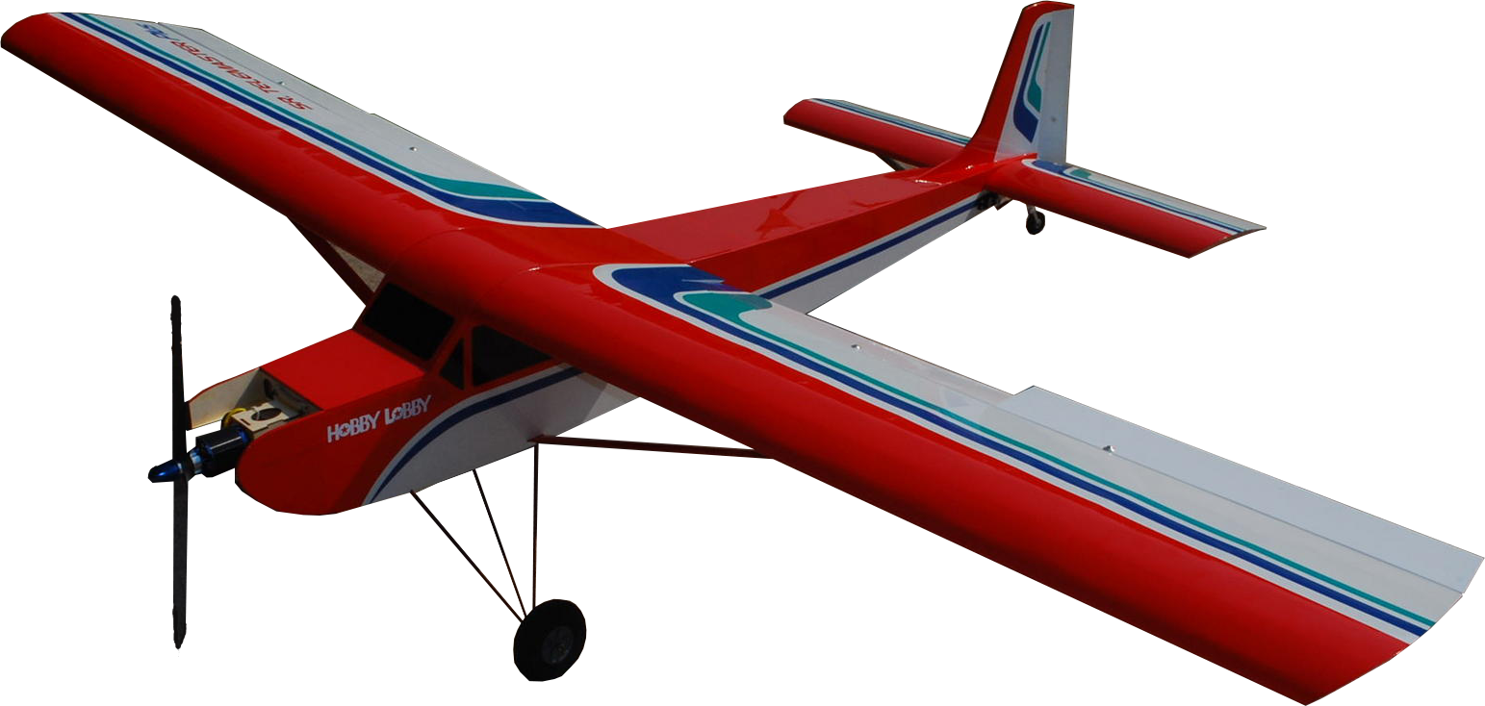

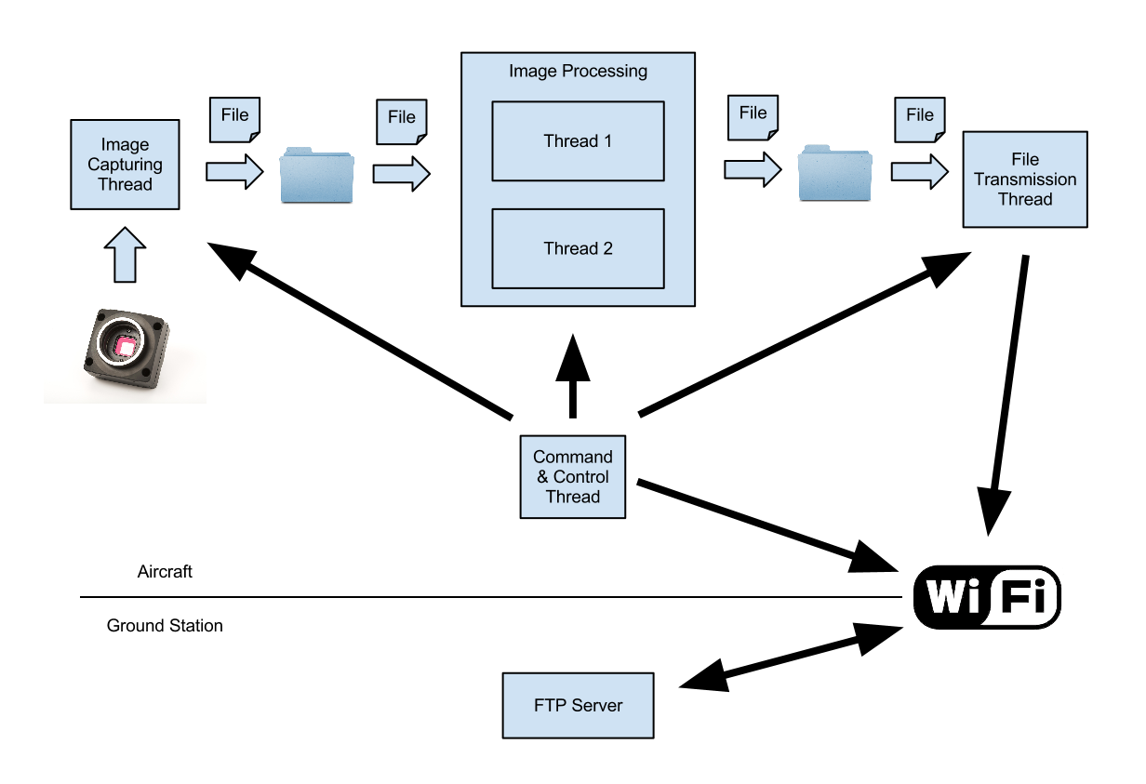
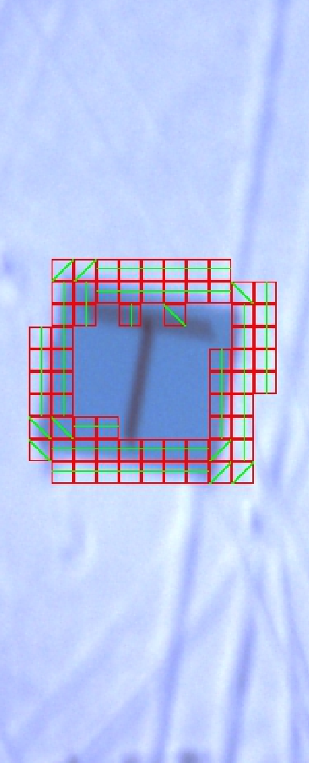
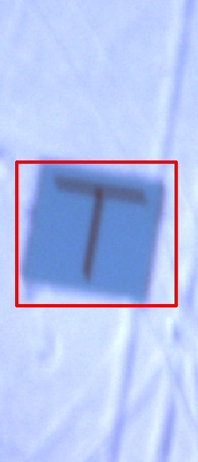
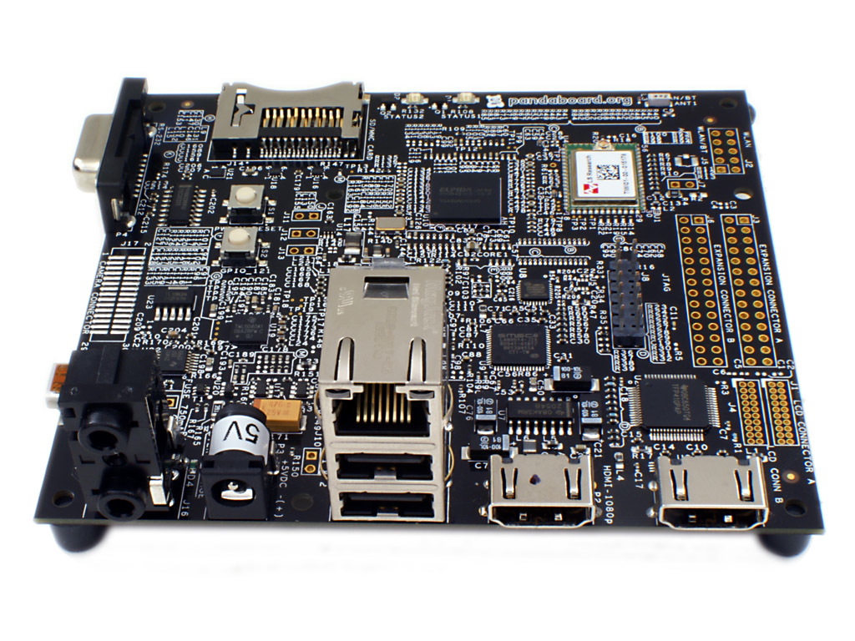

CMPE 450/490 Capstone Design Project
UAV Imaging
Shen Yue, Yushi Wang, Yubing Xu (Client : UAARG) | 2012
Software
The main objective and challenge of our software design is performance. The CPU of our PandaBoard is around 25 times slower than the current mainstream desktop CPUs. Image processing is a CPU intensive task that we need to perform in real time. In order to achieve the performance requirements, we have applied a number of techniques such as multi-threading, semaphores, and buffers.
Detection Algorithm
We have found no image-processing algorithm will satisfy our performance requirements. Therefore, we developed our own algorithm from scratch.
The algorithm consists of three main stages:
Identify any edges on the image.
Group edges to form objects.
Check dimension and shape of objects to identify markers.
Overview
The UAV imaging is an image process for UAARG (U of A Aerial Robotics Group) to identify markers on the ground. Processed images are sent back to the ground station.
A camera carried by the plane is used to photograph a research area from the air, and then our software implemented on PandaBoard analyzes full resolution images taken by the camera. Markers including their shapes could be recognized. These processed images are then compressed and transmitted to the ground station.
Results
Detection Accuracy: 70% ~ 99% (depending the background complexity)
Maximum Capturing Rate: 6.8 FPS
Average Processing Rate: 5.0 FPS
Hardware
Chameleon camera | PandaBoard
- USB 2.0 | - Dual-Core 1.2 GHz ARM Cortex-A9 CPU
- CD Sensor
- Global Shutter | - 1 GB DDR2 SDRAM
- Bayer Pattern Image | - Ethernet & Wireless
- 1296 x 964 Pixels | - 5 V Power Supply
The image capturing thread controls the camera to take pictures at a dynamic rate calculated form the altitude and height of the airplane to ensure just enough pictures are taken to cover all ground the plane flies over.
The image processing component has two identical threads to take full advantage of the dual-core CPU. These threads locate any marker on the image, identify the shape of the marker, and compress the image. The compression ratio is dynamically calculated based on the transmission rate.
The transmission thread transmits the compressed image along with information of the image to the ground FTP server.
The control and command thread allows us to change any settings of the program from the ground station.
Department of Electrical & Computer Engineering

