Slide 1
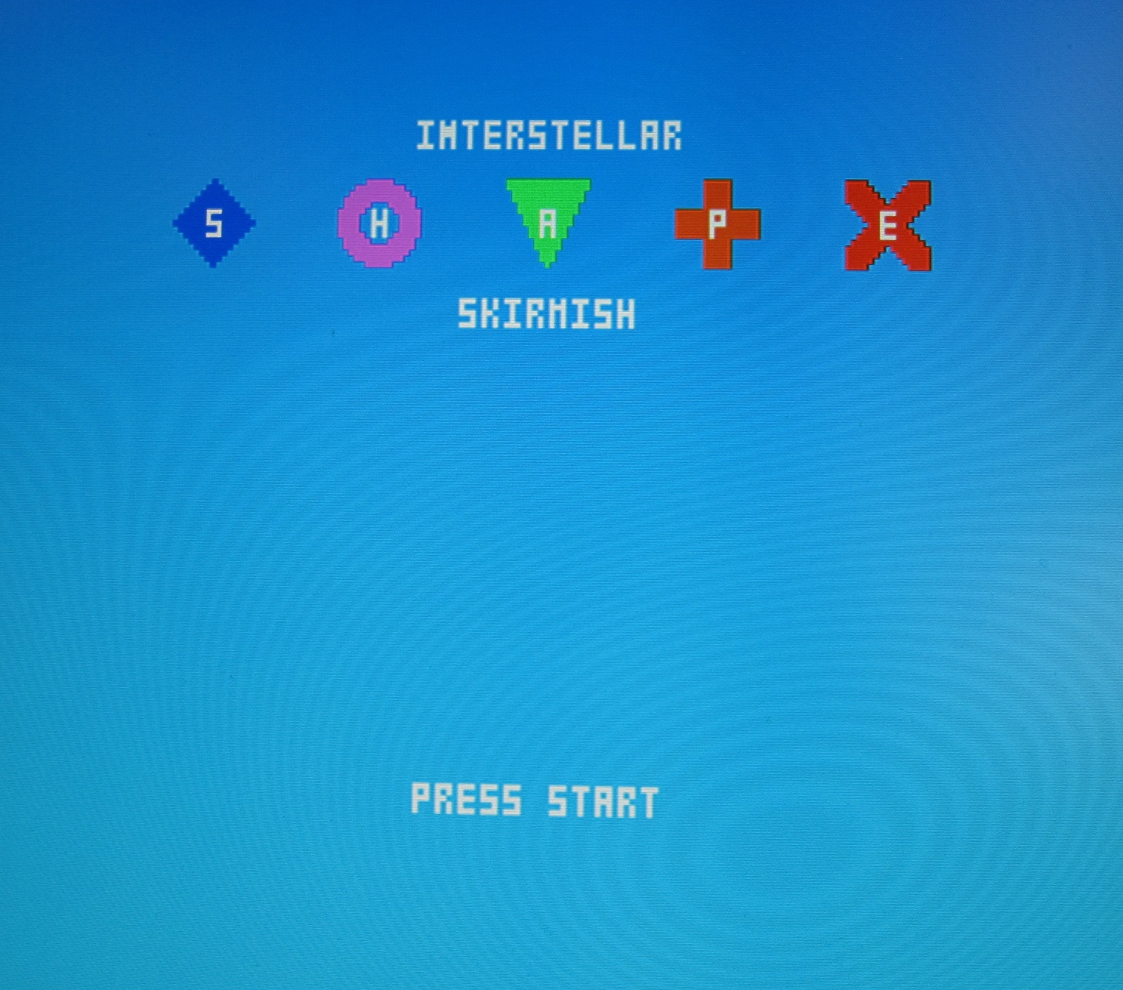
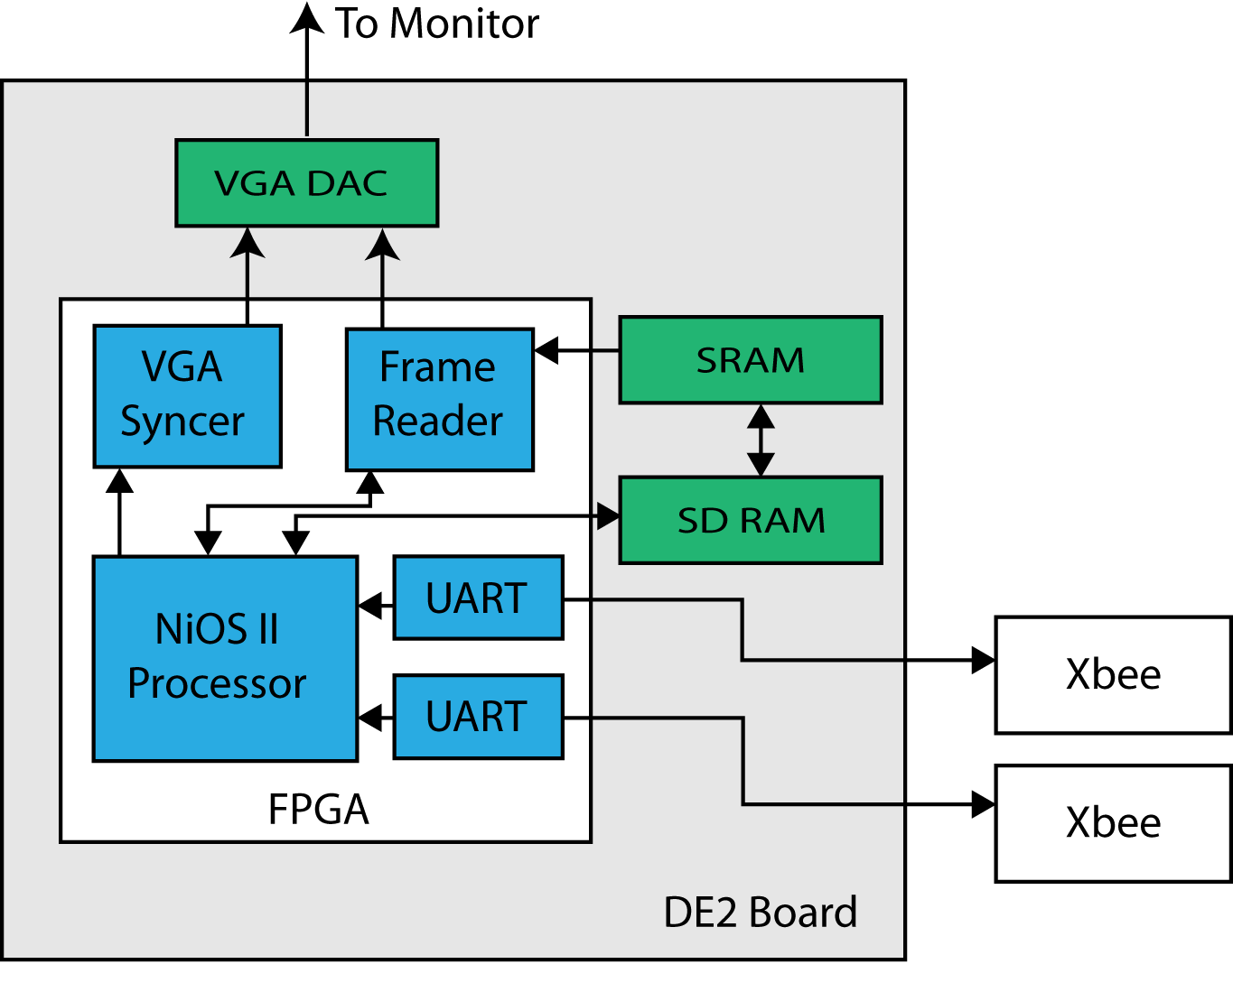
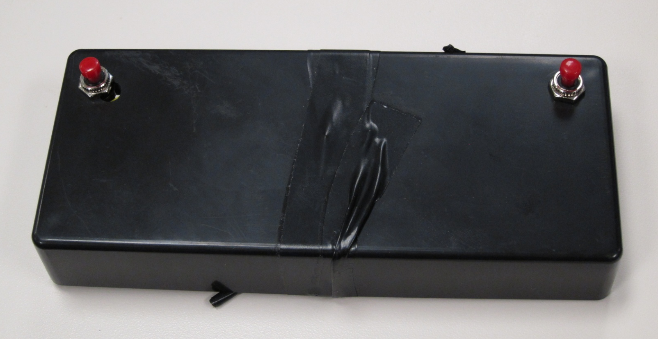
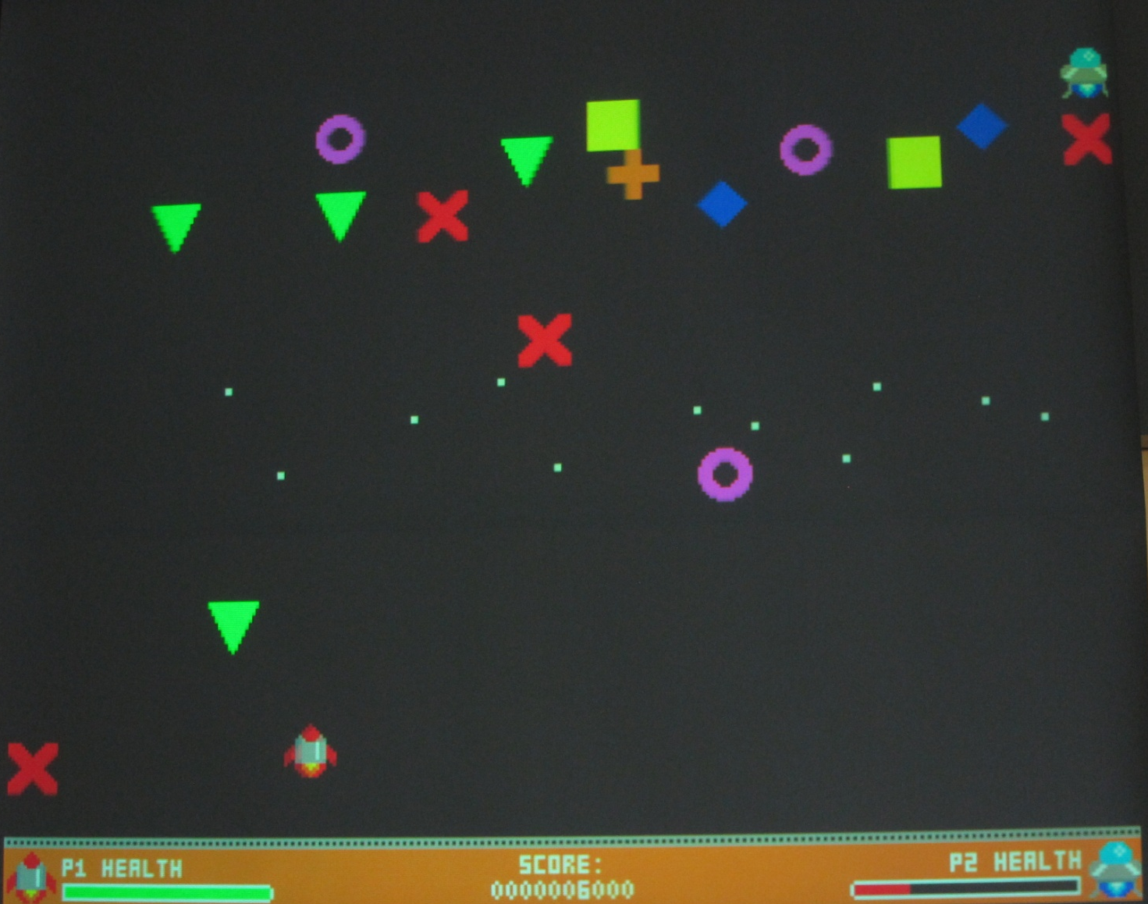
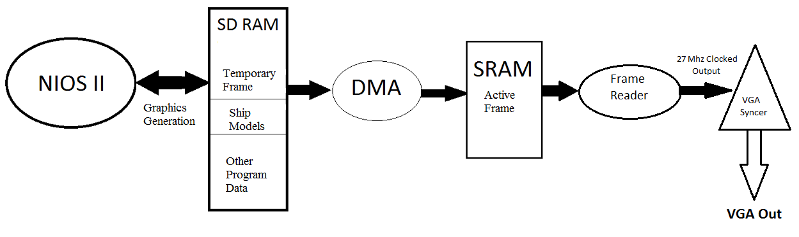

CMPE 450/490 Capstone Design Project
Video Game with Accelerometer-based Controls
Billy Kozak, Nathan Sinnamon, Jeff Theriault | 2012
Project Overview
Our group created an (up to two-player) original video game similar to classic space-shooter arcade games such as Taito Corporation’s Space Invaders. This project centered on the use of the Altera DE2 development board and the NIOSII microprocessor, and the necessary software was written using µC/OSII. The aim of the game is to shoot down and evade enemy spacecraft and their projectiles using accelerometer-based controllers which we also created.
Controllers
We created our own controllers which use motion-based gestures to control the player ships. Each controller has a triple-axis accelerometer that allows us to measure the controller’s motion through space. Armed with these acceleration measurements we are able to determine how the controller is being rotated (by calculating roll and pitch angles) and feed this information into the game engine. The controllers take advantage of the wireless ZigBee protocol to eliminate the need for cables connecting the controllers to the main unit.
Game Engine Design
The game engine works by repeating 8 basic steps.
Step 1 fetches new ships from memory and places them onscreen if the correct amount of time has elapsed.
Step 2 reads data from the controllers and updates the player ship’s positions.
Step 3 updates locations of the enemy ships as determined by simple AI routines.
Step 4 updates the locations of all onscreen projectiles
Step 5 detect collisions and resolve collisions (between two or more ships or a ship and a projectile)
Step 6 redraws every ship and projectile according to its updated position (dead ships/ projectiles are erased)
Step 7 detect for victory or loss conditions so we can
Step 8 update the game’s time counter and ensure that we don’t go back to step 1 until 15ms have passed
Fig. 4 Game Title Screenshot
Fig. 2 Game Controller
Fig. 1 Block Diagram
VGA Buffer System Design
The VGA buffer system works using two RAM memories, a DMA device provided by Altera, and two custom components designed to continuously write frames to VGA output. We designed a frame reader in VHDL to continuously read a 320x240 image (15 bit) from the SRAM and a VGA syncer to read buffered lines (1 line buffered at a time) from the frame reader to generate the VGA output signals. A temporary frame is stored on the SDRAM which is then copied to the SRAM for VGA output.
Fig. 5 Game Screenshot
Fig. 3 VGA Buffer System
Department of Electrical & Computer Engineering
Notes:
For colour ideas, University Visual Identity Guidelines can be found here: http://www.toolkit.ualberta.ca/VisualIdentityGuidelines.aspx

