Slide 1
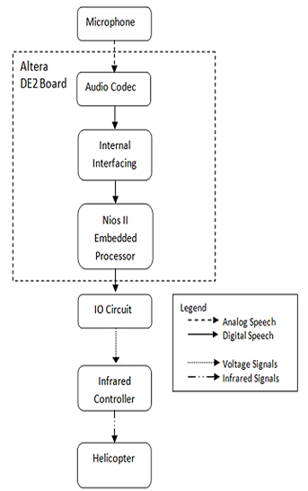
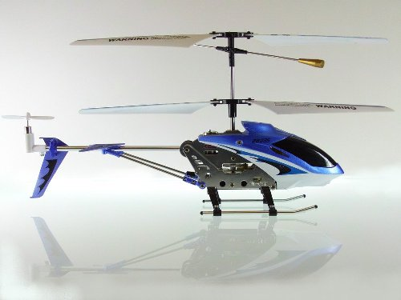
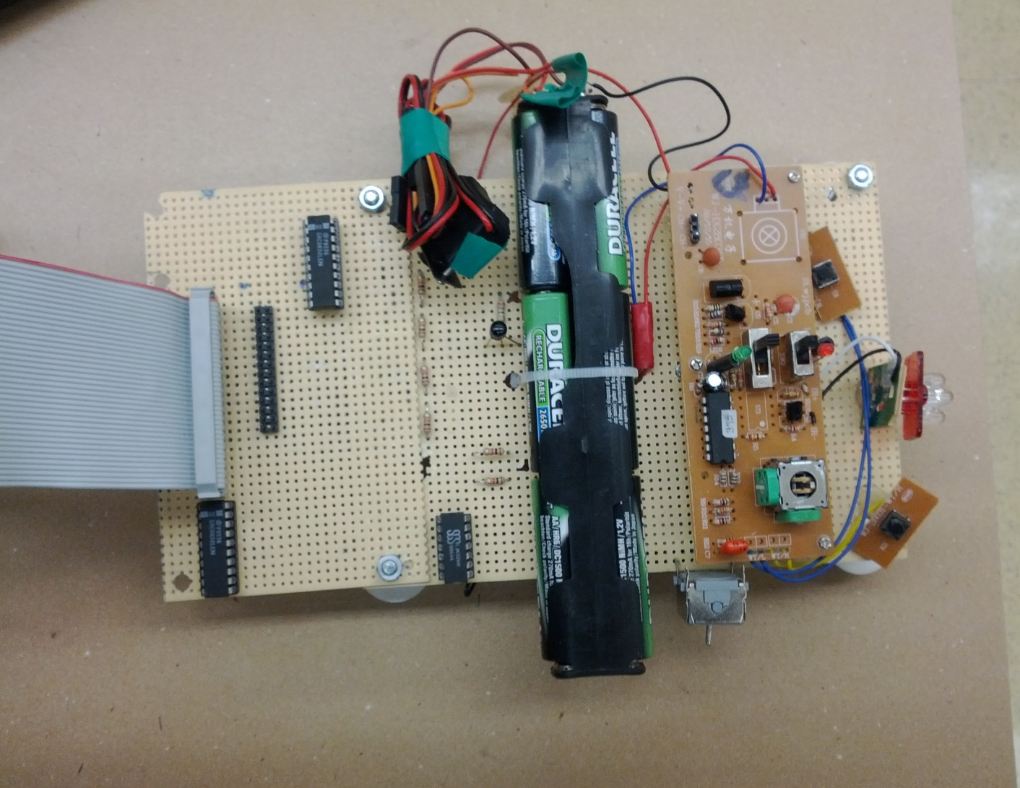
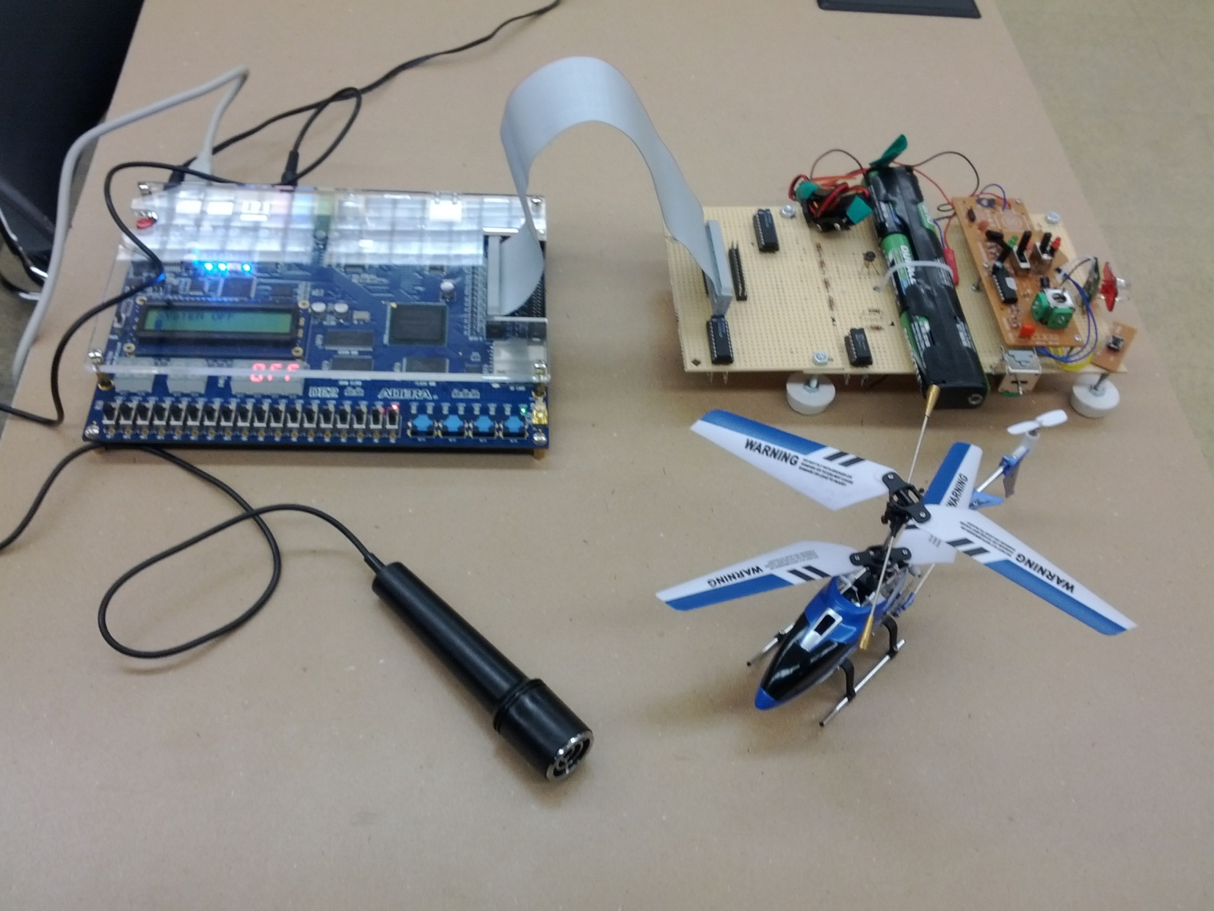

CMPE 450/490 Capstone Design Project
Voice Controlled Helicopter
Jonathan Lam, Mian Zhu | 2012
Introduction
Until this day, voice recognition remains a crucial technology and as time progresses we observe more and more devices holding the capability of being controlled via voice. Therefore, we believe that implementing a voice-controlled helicopter is not only interesting and unique, but would not only allow those who are physically challenged be capable of controlling a helicopter using solely their voice.
Features
Helicopter responds to 4 different voice commands, which include: Up, Down, Start and Land.
-Voice recognition system is capable of filtering out invalid commands.
-Users are capable of controlling the helicopter either through voice or interactions with the onboard controls (switches, buttons) on the Altera DE2.
-The onboard LEDs indicate the strength of the spoken voice command.
-The onboard LCD display displays various information regarding the spoken command and the state of the system (ON/OFF), as well as, other user interactive messages.
Block Diagram of Operation
IO Circuit
Our IO Circuit contains 5 major components, which allows us to translate the digital signals coming from Altera DE2 to analog signals that the infrared controller recognizes. These components include: a 9V battery source, a digital-to-analog convertor, an operational amplifier, a npn transistor and an infrared controller that transmits infrared signals to the helicopter.
Fig. 1 Helicopter that is used in Project
Fig. 4 IO Circuit
Project Goals
Design an interface between the Altera DE2 and a mini radio controlled helicopter such that the helicopter itself could be controlled using voice commands that the Altera DE2 recognizes.
Voice Recognition Algorithm
-We distinguish valid and invalid commands based on 3 different criteria: Word Length, The Maximum Amplitude of the Word and The Minimum Negative Amplitude of the Word.
-If 2 out of the 3 criteria fall in the matching range, then the command is considered valid, otherwise, it is filtered out.
Fig. 3 Block Diagram of Operation
Fig. 2 Picture of System
Department of Electrical & Computer Engineering
Notes:
For colour ideas, University Visual Identity Guidelines can be found here: http://www.toolkit.ualberta.ca/VisualIdentityGuidelines.aspx

