Slide 1
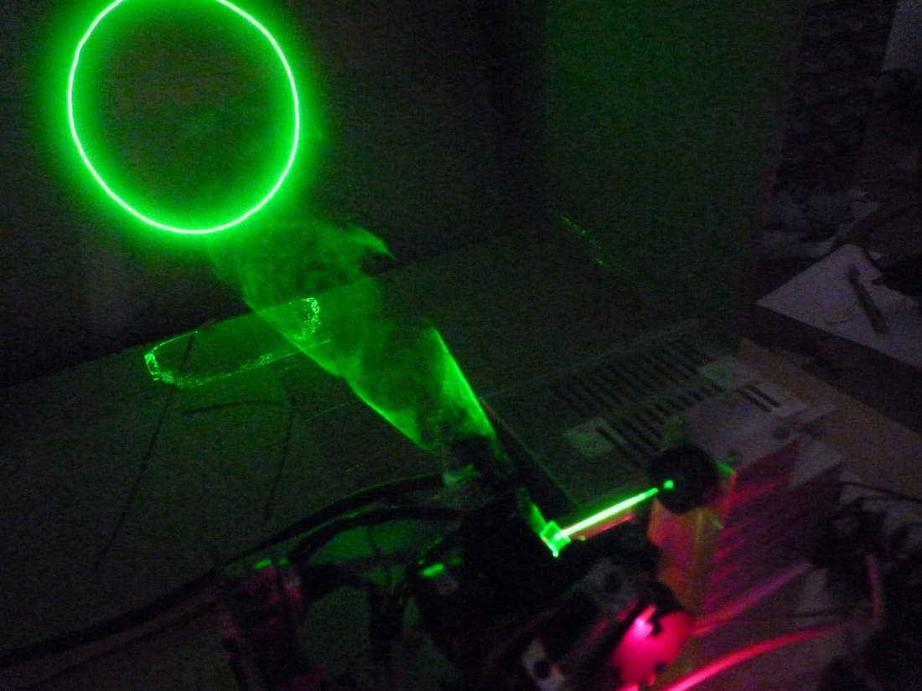
Laser Projector
Michael Ivey
Josh Ibach-MacKeen
CMPE 490 Capstone Project
Notes:
Hi, I’m Josh, I’m Mike and we’re here to present a laser projector. Our final marks hinge on this presentation, so please clap loudly. Also, I hear Dr. Elliott and our lab instructor, Nancy, are accepting bribes. You can find them here *point*

Slide 2
Laser Projector?
A laser projector is a device which uses a laser to either:
  Draw images and/or text
  or
  Provide visual effects
Notes:
Josh
-Many different colors available: rgb
-This one is a monochromatic green one
-Different intensities; this uses a relatively small laser; commercial ones at bars use ones 2x+ as powerful, concerts use ones 100x as powerful

Slide 3
Persistence of Vision
Redraws (almost) the same image at a high speed (typically 15-30+ frames per second)
The laser beam is moved rapidly from point to point, like connect the dots
Variable refresh rate; depends on the number of points (vectors) in an image
Notes:
Mike-Josh-Mike
Explain how POV works, briefly. The image is refreshed so quickly that it appears to be continuous. Kind of like TV, or CRT-based oscilloscopes/televisions.
Demonstrate a continuous image; image after that should be the same pic with delay. Explain how it works.

Slide 4
Effects
Laser projectors used in many concerts, night clubs, and other large productions
Typically rely on fog/haze
  The laser beam scatters off the fine particles in the air, making the beam itself visible
Notes:
Josh
-Might have seen a laser used to that effect during a production
-Normally a laser beam is not visible; needs to be scattered off something; describe why the fog does this briefly
-[Put some fog into the room; demo single point then a box]

Slide 5
How a Laser Projector Works
Most laser projectors shine a laser beam onto a moving mirror or mirrors
  (This is easier to do than waving the laser itself around hastily.)
Most commercial projectors use a pair of mirrors mounted on special motors to deflect the beam in the horizontal and vertical directions
Notes:
Mike
Mention that the mirrors are mounted on Galvos and what galvos are; how they’re different from other motors
Demo: Slowpt horz, vert

Slide 6
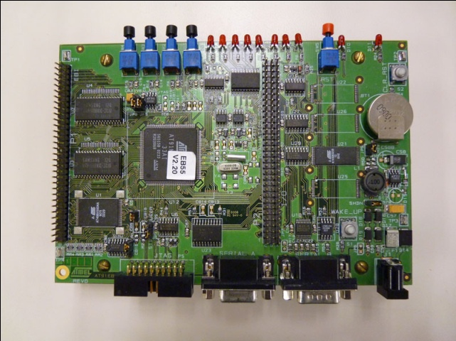
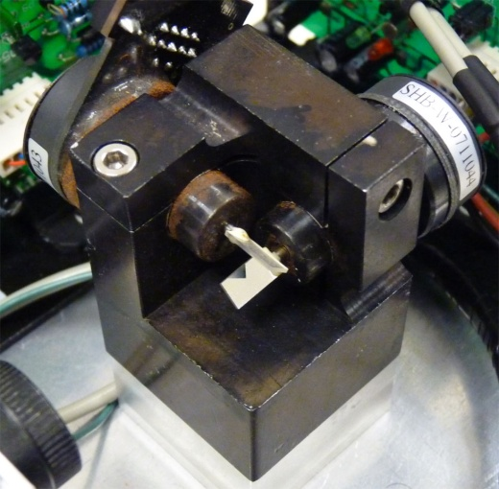
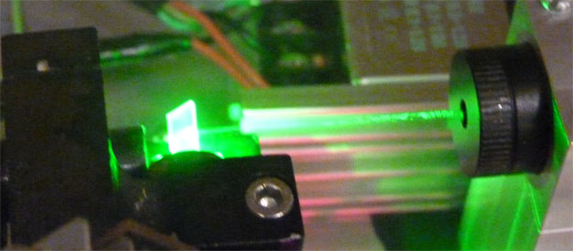
Our Hardware
Atmel AT91EB55 Microcontroller
Lasershowparts ScanPro-30k Galvanometers
3V Class IIIa Green Laser (taken from a Laserglow Orion laser pointer)
Notes:
Josh
-Microcontroller was given to us; ARM7-based, lots of built in hardware; about 5 yrs old, 32b
-Galvos were ordered. Come with controller boards that deal with inertial damping + frequency damping
-> also came with their own power supply
->Bought pre-tuned at 30 kpps
-Laser from a laserpointer; tore it open and took out the laser module

Slide 7
Implementation
Three important steps in making the projector work:
  Control the galvanometers
  Control (modulate) the laser
  Parse image files into a format the system can draw
Notes:
Mike
-Galvos: they draw the picture
-Modulation: needed to control the brightness of the laser (in this case, only on and off; more complex systems can do brightness gradients)
-Parsing: need to have something to draw; easier than programatically generating effects (e.g. Tell the laser to move left for 20 pts, then do this... Blah blah)

Slide 8
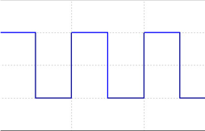
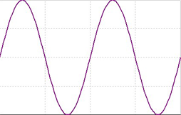
Galvanometer Control
The galvanometers accept an analog input signal
Needed to convert the digital signal inside the microprocessor to analog waveforms
Utilized on the onboard Digital to Analog Converters (DACs) for this purpose
Digital
Analog
Notes:
Josh
-Computers store things digitally, in binary. The real world requires analog signals, though.
-DACs are quite fast; 5 us settle time. Successfully drove a 60 kHz wave in tests
->a little noisy though. Had to clean up the signal a bit with a simple low pass filter (fstop=50kHz)
-In retrospect, might have used an offboard pair of DACs; more configurable and greater precision

Slide 9
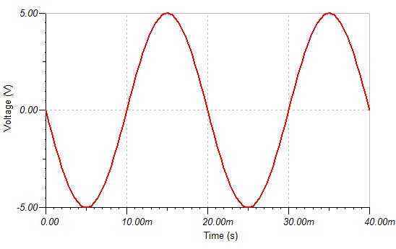
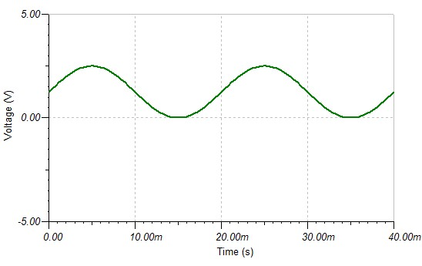
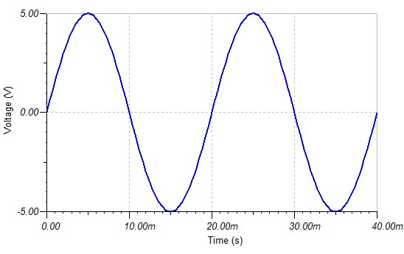
Analog Issues
DACs output 0 – 2.5 V analog
Galvanometers require ±5 V differential input
Notes:
Josh
-Galvos do subtraction to produce a ±10 V input
-Ideally the differential waveforms should be generated independently; this reduces common mode noise
-We took a slightly different approach...

Slide 10
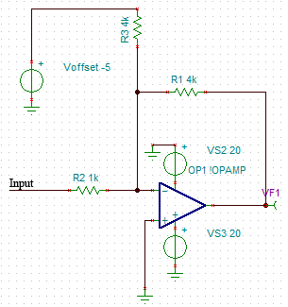
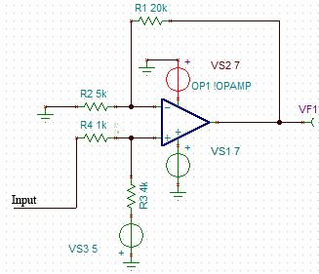
So We Built Some Amplifiers...
Non-Inverting Amplifier
Inverting Amplifier
Notes:
Mike
-We used 4x amplifiers; one inverting, one non-inverting for each channel
-This, in fact, doubles common mode noise ☹
-Sufficient for this project though; if done again, would use 4 offboard dacs

Slide 11
Mirror Synchronization
In order to function properly, a new point (vector) must be drawn at a constant rate
  This projector draws 30,000 points per second
DACs were synchronized with an onboard Timer Counter running at 30 kHz
Coordinates of new points are placed into Data Holding Registers (DHRs)
DHRs are expressed at the output on every Timer Counter event
Notes:
Josh
-TCs configured to use RC compare events. Used MCK/2 = 16 kHz; Therefore need 533 ticks before a transition
-DACs sync programmatically to the TCs (interrupt handled internally)
-PIO pin had to have an interrupt generated

Slide 12
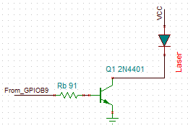
Laser Modulation
In order to draw a discontinuous image, have to lift the “pen” off the “paper”
Modulated the laser using a digital output pin of the microcontroller connected to a BJT switch
Notes:
Mike
Note that this is not the most efficient scheme; would be better to build a modulating driver; more complex, but greater precision

Slide 13
Laser Synchronization
To synchronize the output of the laser, the same Timer Counter used for the DACs was set to generate an interrupt
The interrupt handler writes the currently desired value of the laser output to the GPIO pin
Interrupt handler also increments a cycle counter
Notes:
Mike
-Works similar in fashion to the DACs; global variable was used to hold output data
-counter useful for delays; it’s how we produced the slow version of the image earlier while discussing POV

Slide 14
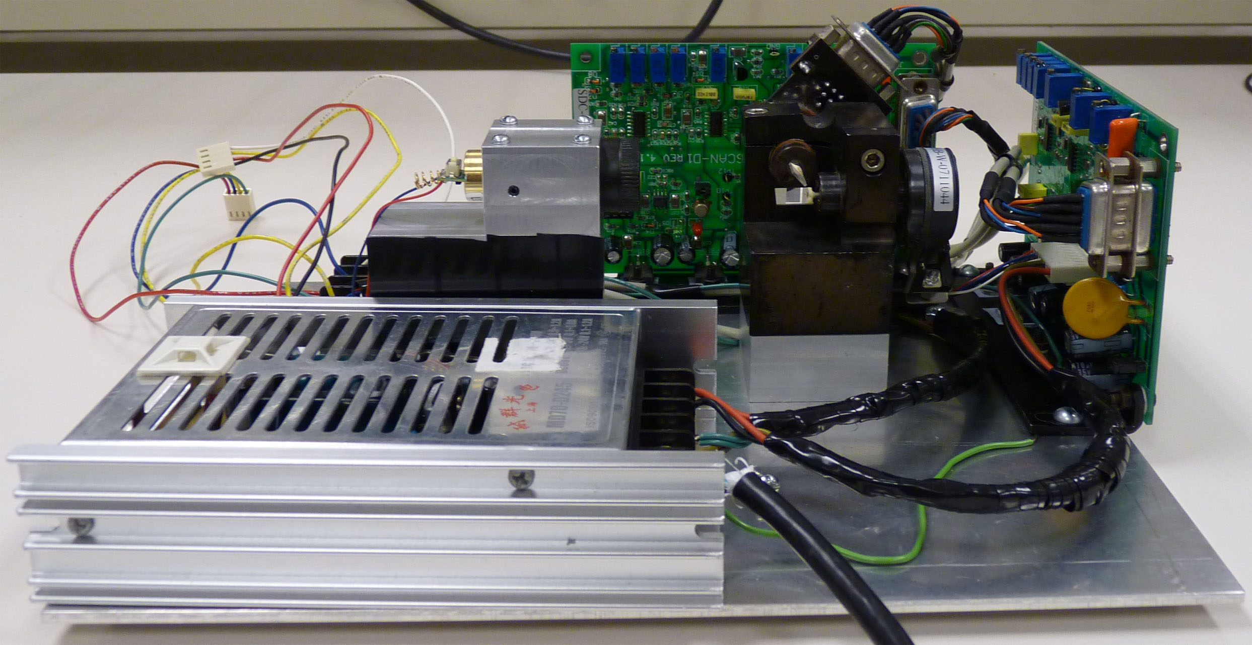
The Final Product
Notes:
Gesture to the laser module, the galvos an the driver boards

Slide 15
Image Parsing
Many vector images available online in the International Laser Display Association’s (ILDA) file format
Had to parse those files into a coherent set of points for the projector
Notes:
Mike

Slide 16
Image Parsing Issues
ILDA files are binary packed; wrote a parser in C to convert to a static array of u_shorts
Standard ILDA format uses a range of positive and negative numbers [-32768, 32767]
  The DACs use an input range of [0, 1023]
  Had to shift and down-sample the values
Limited by hardware; ILDA supports 16 bit points, had only 10 bits of DAC resolution

Slide 17
Drawing the Pictures
Once the ILDA files were converted, the projector was configured to display each array over and over
Each image has its own subroutine
Current image is selected by pushbutton; interrupt is generated which iterates a state machine, moving to the next display subroutine
Notes:
Josh
-Static array of pts
-own subroutine per image
-State machine
-asychronously interruptible
Over 3 months, all of these things have culminated in the final result which you see here today…

Slide 18

Notes:
SUPERSTRING!

Slide 19
The End!
Notes:
Thanks for listening; we hope we didn’t blind you.
Please send cheques to…

Slide 20
Questions?
Notes:
Ask your questions now!

