Slide 1

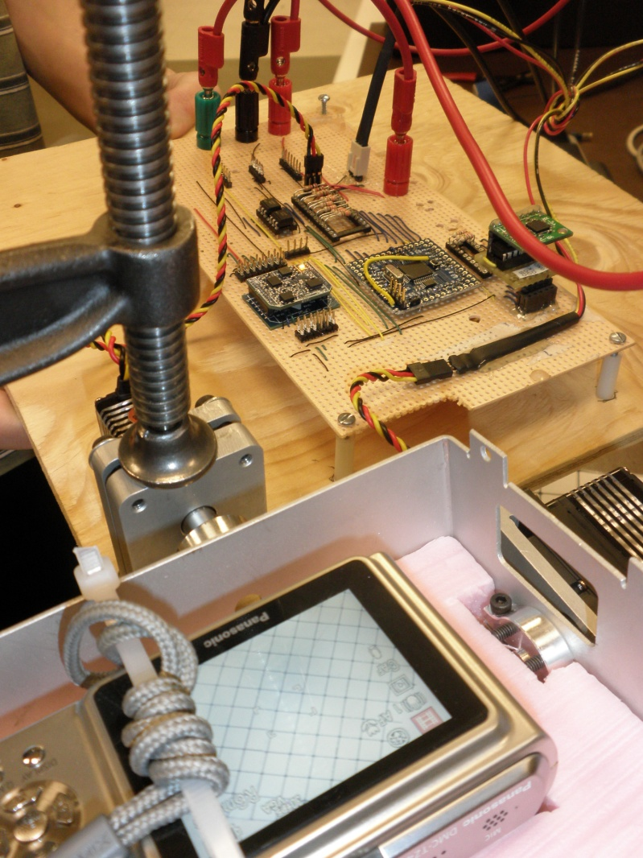
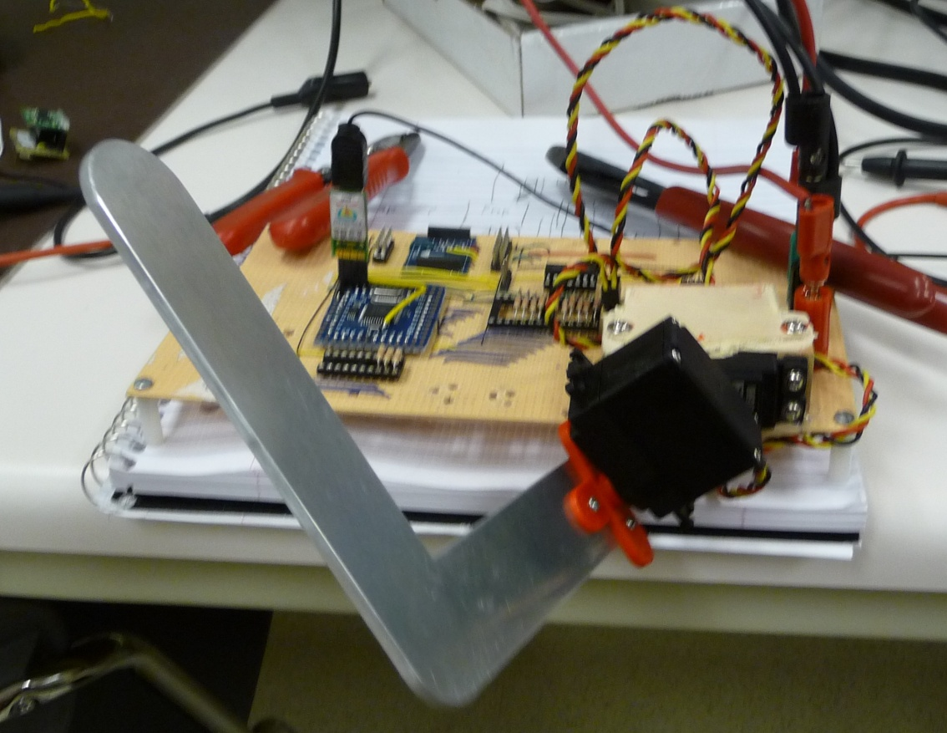
Dynamic CAMERA STABILIZATION SYSTEM
Reegan Worobec & David Sloan
In collaboration with UAARG

Slide 2
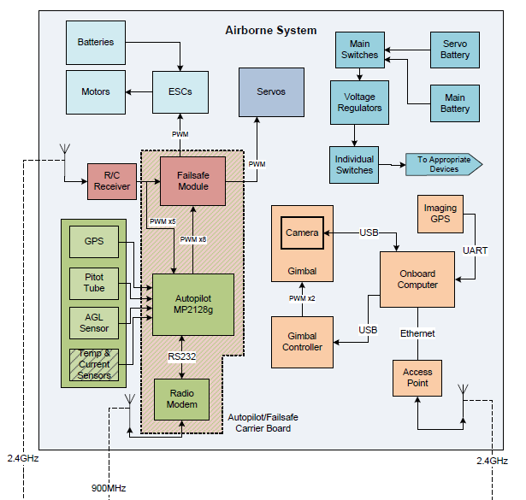
WHAT IS IT?

Slide 3
WHAT IS IT?
An additional system intended to enhance the image processing capabilities of UAARGs UAV
A dynamic stability controller that updates its position in real time based on aircraft pitch and roll
Has the potential to track ground targets given their GPS coordinates

Slide 4
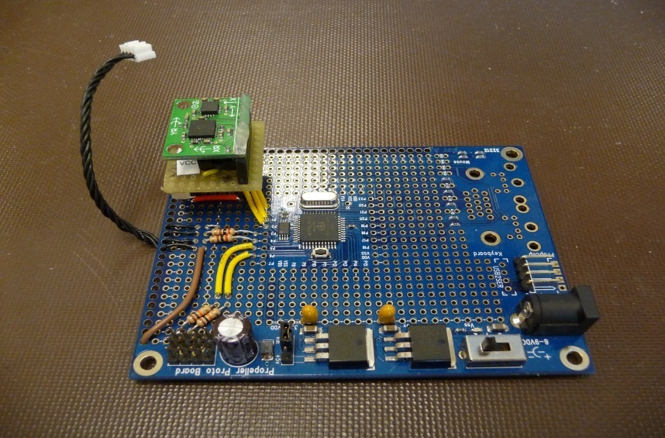
WHAT DOES IT DO?
Stabilizes a camera platform relative to ground independent of aircraft pitch and roll
  Gathers sensor data from an onboard GPS and IMU (Inertial Measurement Unit) and stabilizes a camera platform by means of a pair of servo motors

Slide 5
OUR GOAL
Develop a system utilizing an FPGA
Keep platform stabilized
  Read GPS data, send positional instructions to servo motors to adjust platform
GPS point tracking
  Set camera angle at fixed location as opposed to relative ground plane

Slide 6
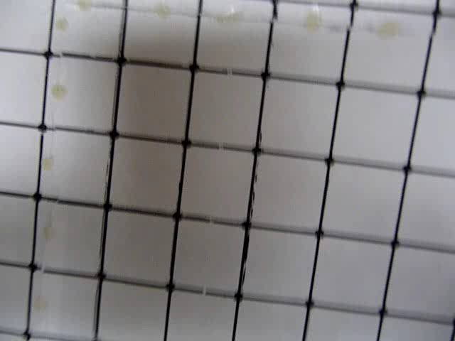
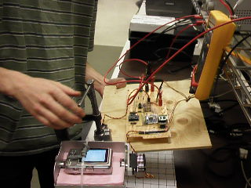
ACTION!

Slide 7
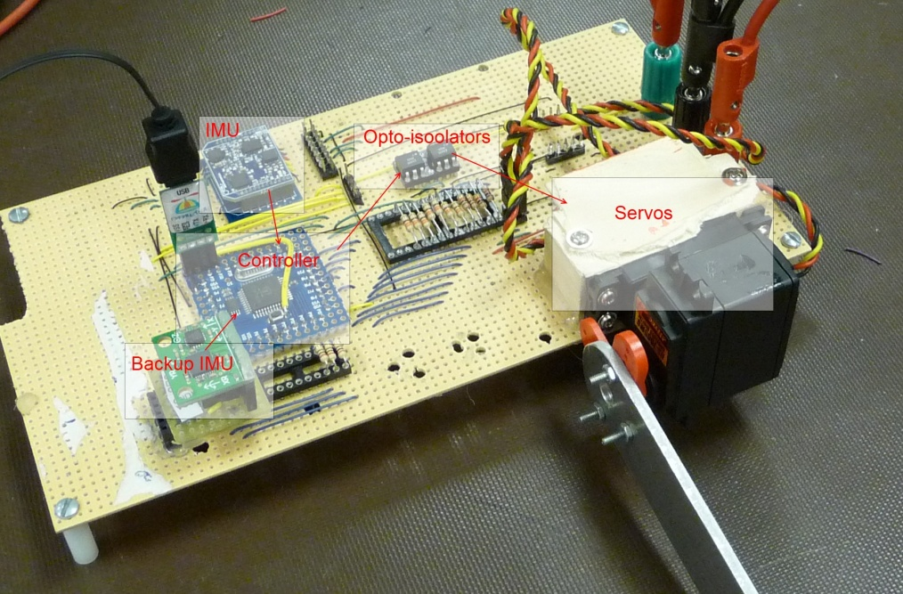
HOW DOES IT DO THIS?
The IMU takes measurements at a rate of 50Hz and calculates required servo positions
This information is then forwarded to the PWM controller to update the servo motor positions
It constantly polls for these updates, sending speed calibration data from the GPS to the IMU, and adjusts camera angle
Notes:
The IMU takes measurements from a set of 4 sensors, an accelerometer, two gyros, and a magnometer or digital compass and computes a current roll, pitch and yaw. This information is then used by the embedded microcontroller to calculate required servo positions to maintain a level camera platform.

Slide 8
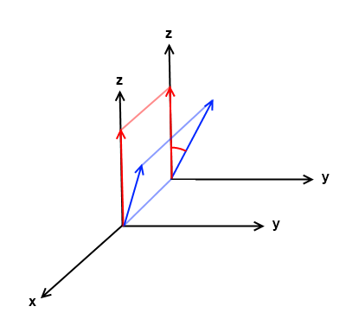
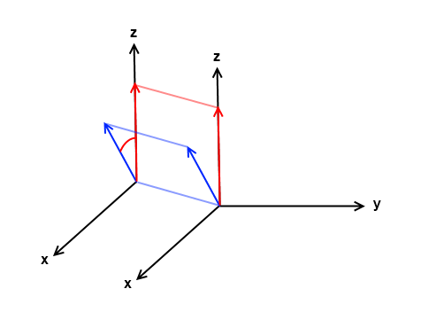
HOW DOES IT DO THIS? (con’t)
Essential Matrix math
  Normalize input vectors (frame orientation, and gimble orientation)
  Project onto the frame servo’s rotational plane
  Calculate first servo rotation
  Transform frame orientation with new servo position
  Project onto the second servo’s rotational plane
  Calculate second servo rotation and update servo positions
GPS parsing*
  Reads in NMEA sentences and parses for
  relevant information
*Function completed in a desktop environment but not implemented in demo project
Notes:
The servo positions are calculated from a two vectors.
One which represents the current orientation of the air frame, and one representing the desired orientation of the camera gimbal.
This is accomplished by first projecting the two vectors onto the servo connected to the air frame’s rotational plane and calculating the angle between them. This angle is stored defining that servo’s position. A 3-D transform is then applied to the airframes vector using the initial servo angle to make the reference now the arm of the gimbal. And the process is repeated for the second servo.

Slide 9
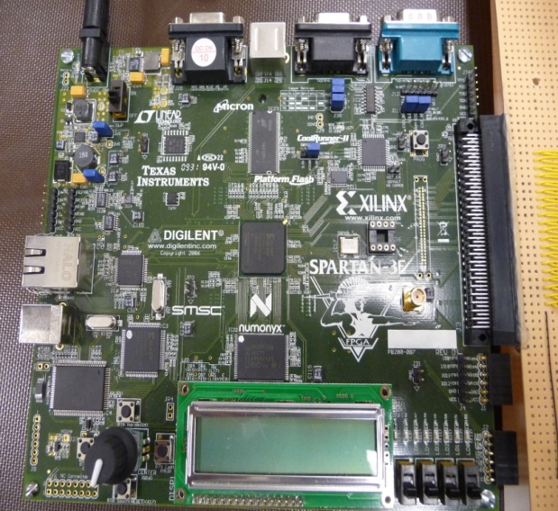
THE FPGA
The initial design utilized an
FPGA as a reconfigurable microcontroller
  Communicates with Inertial Measurement Unit (IMU), GPS, Flight Computer, and two servo motors
  Sends information to servos via PWM controllers
Notes:
Our initial design used an fpga as a configurable core. This was designed to be a set of hardware cores intended to minimize the software load on the system and latency from IMU updates to servo update. Hardware cores included 3 UART serial interfaces for the IMU, GPS, and flight computer. An SPI interface for High-frequency(200Hz) IMU inputs. An Interrupt controller and two specialized PWM controllers for servo control were created by our group.

Slide 10
SYSTEM VIEW (WITH FPGA)
Notes:
Here is a simple diagram of our fpga based design. Outside the green box are the external components required for signal conversion and electrical isolation. And inside are the fpga based systems implemented in our initial design. Our own hardware designs are the Servo controllers shown as one block, and the interrupt controller which combines all the various interrupt sources and feeds them into the micro blazes single interrupt input.

Slide 11
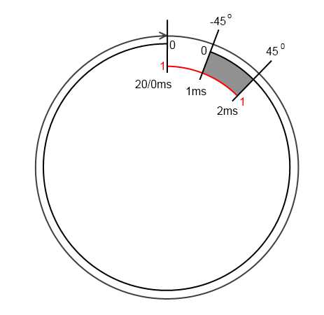
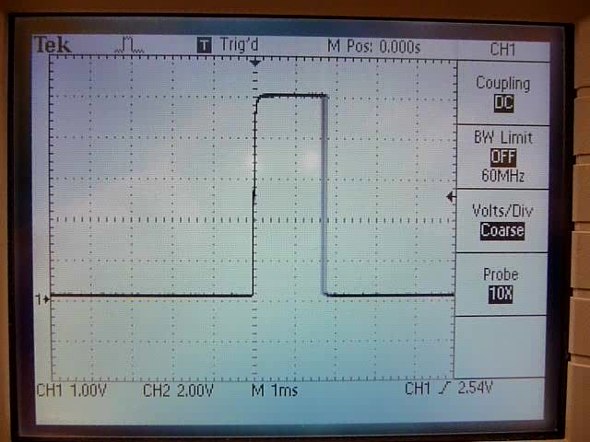
SERVO CONTROLLER
Notes:
The servo controllers were implemented as a comparator and a counter which resets to zero after reaching its maximum value. If the value of the pulse width is less than that of the counter a logical 1 is out put, other wise the result is a logical 0. in the case of our specialized servo PWM controller the pulse width lies in a range from 1 to 2ms, and is repeated 50 times per second. In order to avoid glitches occurring should a pulse width be modified in it’s active region(point at grey area) the register storing the pulse width is only updated when the counter resets from it’s maximum value to zero.

Slide 12
INTERRUPT CONTROLLER
OUT <= IN1 or IN2 or IN3 or IN4
Notes:
The Interrupt Controller...(pause)
The Interrupt Controller signals an interrupt if any of its inputs to high on the rising edge of the system clock. This places the burden on the software interrupt service routine to identify the source which in our implementation is a matter of checking 4 device states and either receiving serial data or updating the servo pulse width.

Slide 13
GPS INVOLVEMENT
GPS information is fed through a UART connection as a continuous stream
We have parsing routines written to extract vital information we need for the microcontroller
  Fix (Latitude/Longitude) converted to radians
  Altitude [m]
  Speed [m/s]
  Speed bearing (direction of travel)
NMEA sentence:
  $GPGGA,123519,4807.038,N,01131.000,E,1,08,0.9,545.4,M,46.9,M,,*47

Slide 14
OBSTACLES
Difficult development environment to interface our components
  Unfamiliar environment to create custom hardware
Numerous operating issues with some of our components
  Two IMU chips became unusable
    one DOA, and a second spontaneously shorted
  FPGA breakout board came with pins un-soldered

Slide 15
SYSTEM VIEW (WITH PROPELLER)
Notes:
Our current system utilizes a propeller chip as the embedded processor as issues with the fpga tools, component failures and the inability to come up with a back up imu quickly on an fpga based platform...(see last slide before continuing)
The propeller chip is used in much the same way as the fpga. It contains 8 cores which are divided among the tasks required in a similar manner to the hardware blocks of the fpga. The GPS stream shown in both this slide and the next was left out in the current version as it is unnecessary for presenting, and would require some assembly optimizations requiring more time that we had available after redesigning around the propeller chip.

Slide 16
SOFTWARE FLOW DIAGRAM
or
Notes:
This is a diagram of the software implementation of the hardware cores used in the initial design. (click)The servo controllers behave in the same manner as they did in hardware in there own core(click). (click)One notable addition it the math library which takes two cores to run all of the required trigonometry and floating point functions implemented in hardware in the microblaze architecture(click). The GPS and flight computer communications shown (click)here differ from the current demonstration implementation as the GPS is ommited in favor of a simpler flight computer serial implementation using two dedicated cores(click). (still need to talk about IMUs and revise)

Slide 17
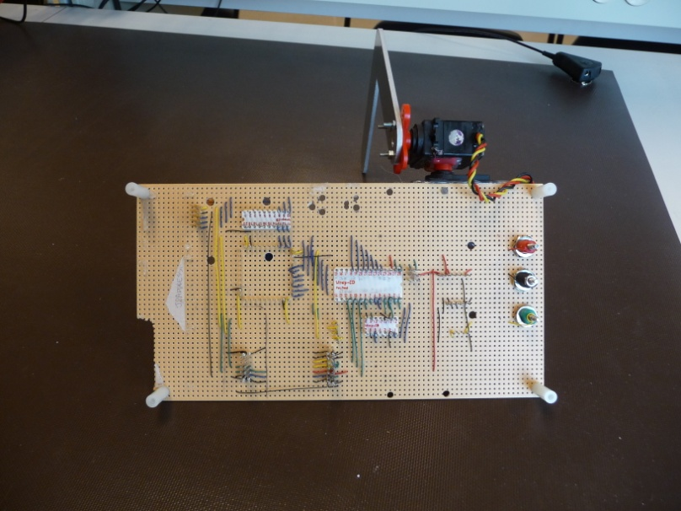
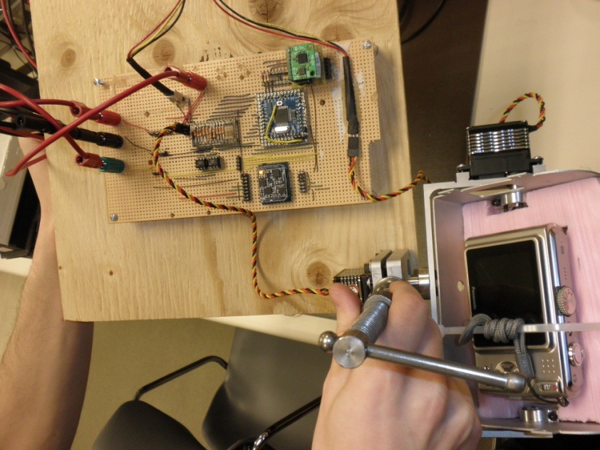
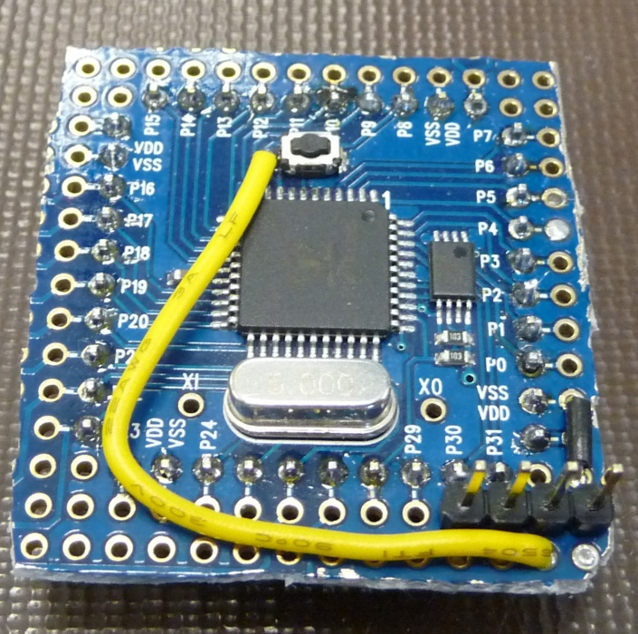
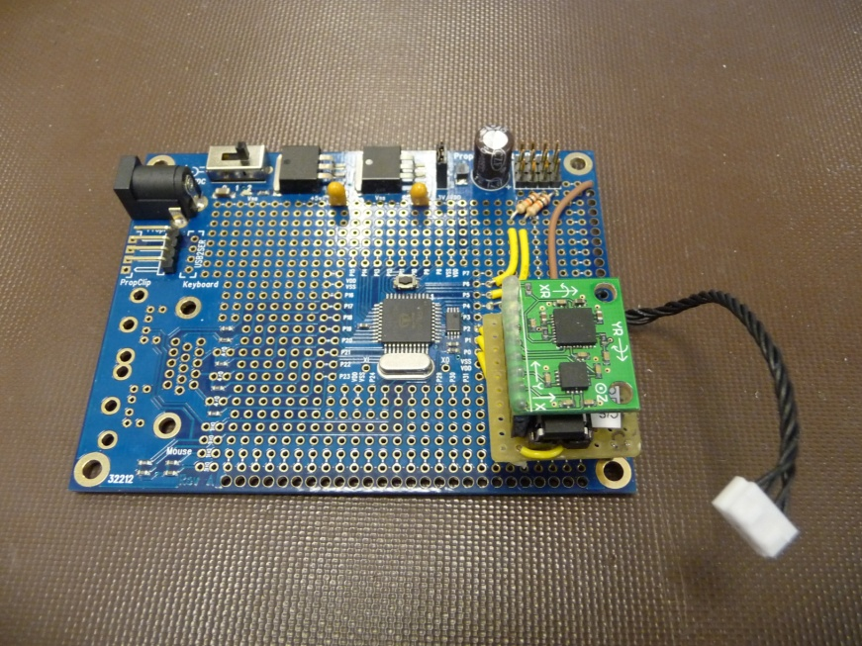
QUESTIONS?

