Slide 1
Performance analysis of channel inversion over MIMO channels
Damith Senaratne and Chintha Tellambura
{damith, chintha}@ece.ualberta.ca
University of Alberta, Canada
Globecom 2009

Slide 2
Outline:
introduction
MIMO, channel inversion
motivation
system model
analysis
numerical results
conclusion

Slide 3
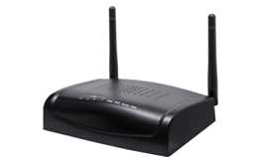
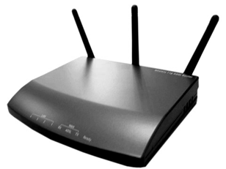
MIMO (Multiple Input Multiple Output) Channel:
E.g:
N_{R}=2
2 × 3 MIMO channel
receiver
N_{T}=3
transmitter
N_{T} = # transmit antennas
N_{R} = # receiver antennas

Slide 4
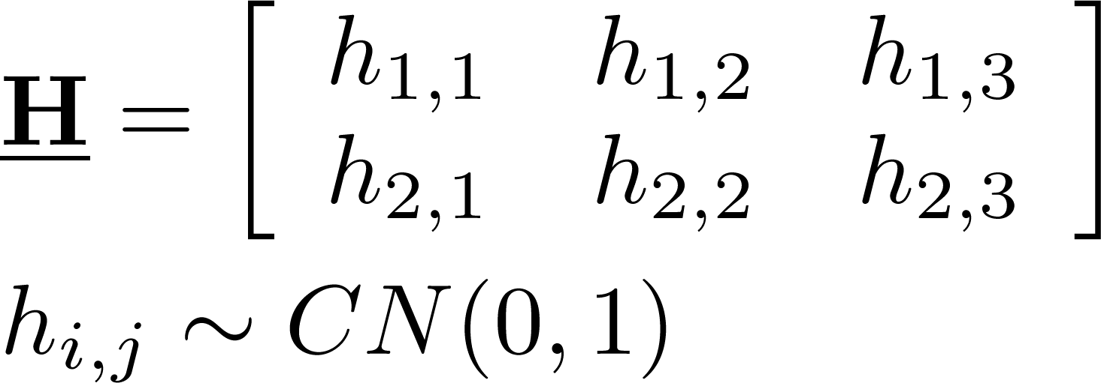
MIMO Channel (ctd):
Assumptions:
- sufficient antenna separation
- isotropic scattering, no LOS
⇒ i.i.d. Rayleigh Channels
N_{R}=2
N_{T}=3
Complex Gaussian MIMO Channel

Slide 5
MIMO Channel (ctd):
N_{R}=2
transmitter
preprocessing
reconstruction
at receiver
N_{T}=3
Eigen channels:
with proper transmitter & receiver processing
- can be independently modulated; power allocated; etc.

Slide 6
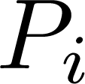
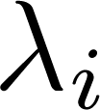
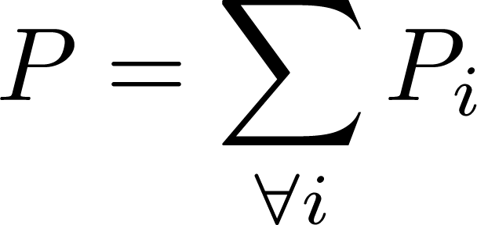
Channel Inversion:
power allocation scheme
assumes: transmit CSI, slow varying channels
allocate total power P among N channels
power to i^{th} channel having SNR
capacity-wise, inferior to water-filling
yields identical channels

Slide 7
Channel Inversion with MIMO:
power allocation, among the Eigen-channels
advantages:
can be implemented in a non-iterative manner
(delay-sensitive applications) [Goldsmith, 2005]
identical rx. SNR distribution for Eigen-channels
signal reconstruction at rx.
can be implemented with linear operations
(no noise enhancement) [Haustein, 2002]
can be avoided (using transmitter preprocessing only)
[Jungnickel, 2001]
reduces to parallel, non-interfering MISO channels
(when N_{T} > N_{R}) [Lee, 2008]

Slide 8
Motivation:
extending exact performance analysis results on MIMO channels
for channel-inversion power allocation scheme
equivalent to
determining the distribution of:
attempted here for the case:

Slide 9
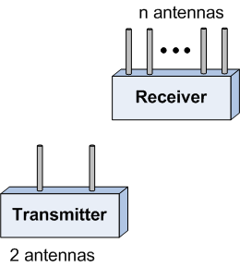
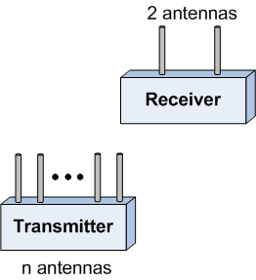
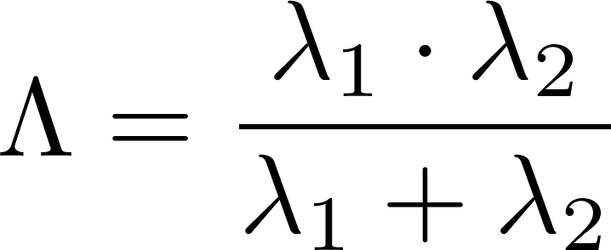
System Model:
or
rx. SNR of any Eigen-channel per unit tx. power:
[Telatar, 1995]

Slide 10
Analysis:
using:
the PDF of λ can be derived as:
also found in closed-form:
the CDF of
symbol-error rate:
(for certain modulation schemes)
allows other performance metrics (e.g. ergodic capacity)
to be evaluated numerically

Slide 11
Analysis (ctd):

Slide 12
Cumulative distribution function of Shannon Capacity (for P = 1)

Slide 13
Cumulative distribution function of Shannon Capacity (for P = 1)

Slide 14
Cumulative distribution function of Shannon Capacity (for P = 1)

Slide 15
Ergodic Capacity

Slide 16
Ergodic Capacity

Slide 17
Ergodic Capacity

Slide 18
average symbol error rate (for BPSK, μ = ν = 1)

Slide 19
average symbol error rate (for BPSK, μ = ν = 1)

Slide 20
average symbol error rate (for BPSK, μ = ν = 1)

Slide 21
Conclusion:
derived: distribution of rx. SNR of any Eigen-channel
MIMO channel associated with a 2×2 Complex Wishart Matrix having n degrees of freedom
under channel-inversion power allocation scheme
closed-form expressions for: average symbol error rate
future directions:
analysis of the same model for water-filling power allocation scheme
extending for Wishart matrices having rank 3 and above

Slide 22
References:
[Goldsmith, 2005] A. Goldsmith, Wireless Communications, 1st ed. New York NY, USA: Cambridge University Press, 2005.
[Haustein, 2002] T. Haustein, C. von Helmolt, E. Jorswieck, V. Jungnickel, and V. Pohl, “Performance of MIMO systems with channel inversion,” in Vehicular Technology Conference, 2002. VTC Spring 2002. IEEE 55th, vol. 1, 2002, pp. 35–39.
[Jungnickel, 2001] V. Jungnickel, T. Haustein, E. Jorswieck, and C. von Helmolt, “A MIMO WLAN based on linear channel inversion,” in MIMO: Communications Systems from Concept to Implementations (Ref. No. 2001/175), IEE Seminar on, Dec. 2001, pp. 1–20.
[Lee, 2008] H. Lee, K. Lee, B. M. Hochwald, and I. Lee, “Regularized channel inversion for multiple-antenna users in multiuser MIMO downlink,” in Communications, 2008. ICC ’08. IEEE International Conference on, May 2008, pp. 3501–3505.
[Telatar, 1995] I. E. Telatar, “Capacity of multi-antenna Gaussian channels,” Bell Laboratories, Lucent Technologies, Tech. Rep., Oct. 1995.

Slide 23
Thank You!

