Slide 1
Numerical computation of the lognormal sum distribution
Damith Senaratne and Chintha Tellambura
{damith, chintha}@ece.ualberta.ca
University of Alberta, Canada
Globecom 2009

Slide 2
Outline:
introduction
  lognormal distribution
  contour integration
computation of the MGF
lognormal sum CDF
numerical results
conclusion

Slide 3
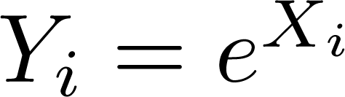
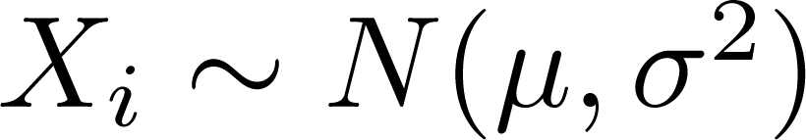
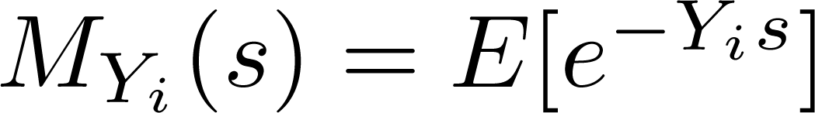
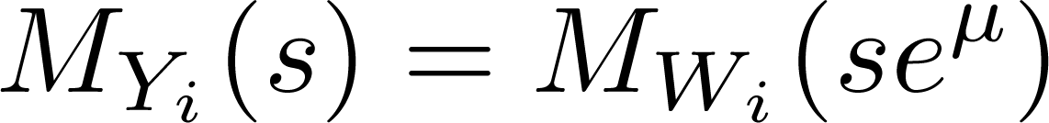
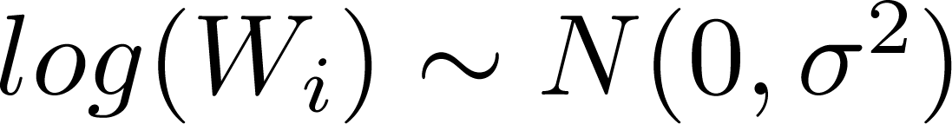
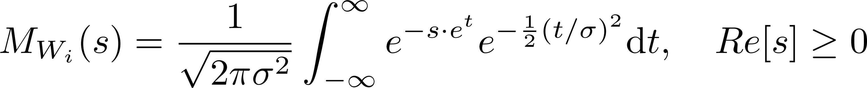
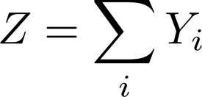
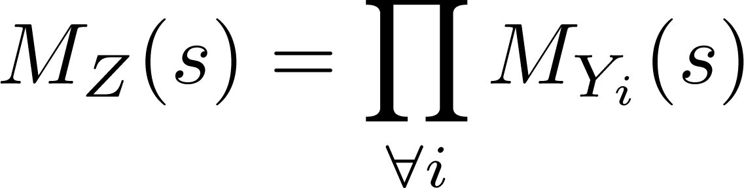
Lognormal sum distribution:
is lognormal, when
moment generating function (mgf):
for lognormal r.v.
where
  no closed-form expression
is a lognormal sum
  for uncorrelated r.v.

Slide 4
Lognormal sum distribution (ctd):
Lognormal sum CDF
  no closed-form
  numerical evaluation tedious
    Lognormal MGF/CHF does not have a closed-form too!
      several work focusing on CHF computation
    direct numerical evaluation, only [BeaulieuXie2004]
  various approximations for Lognormal sum
    by another lognormal: Fenton-Wilkinson [Fenton1960], Schwarz-Yeh [Schwartz1982], Schleher…
    by different distributions: Farley, Log-shifted Gamma distribution , Type IV Pearson distribution, …
    other: least squares estimate [BeaulieuRajwani2004]...

Slide 5
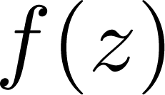


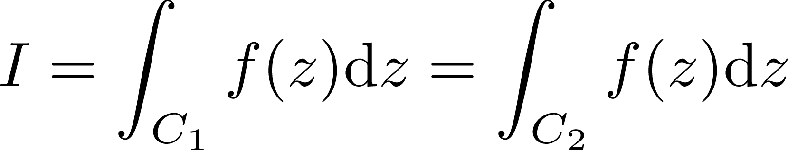


Contour integration:
is analytic at if it satisfies Cauchy-Riemann conditions
if is analytic in region
  principle of path deformation

Slide 6
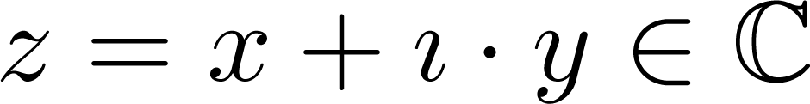
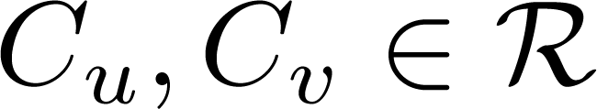
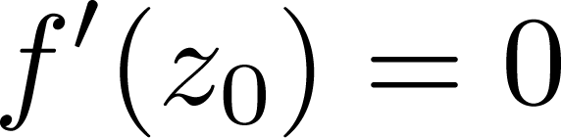

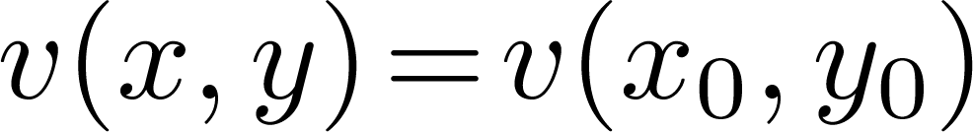
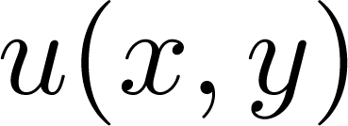
Contour integration (ctd):
let, be analytic at
  from CR conditions, are orthogonal
  for constants
suppose,
  : saddle point
  is the steepest descent contour for
f(x,y)
saddle point
of a real function
x
y

Slide 7
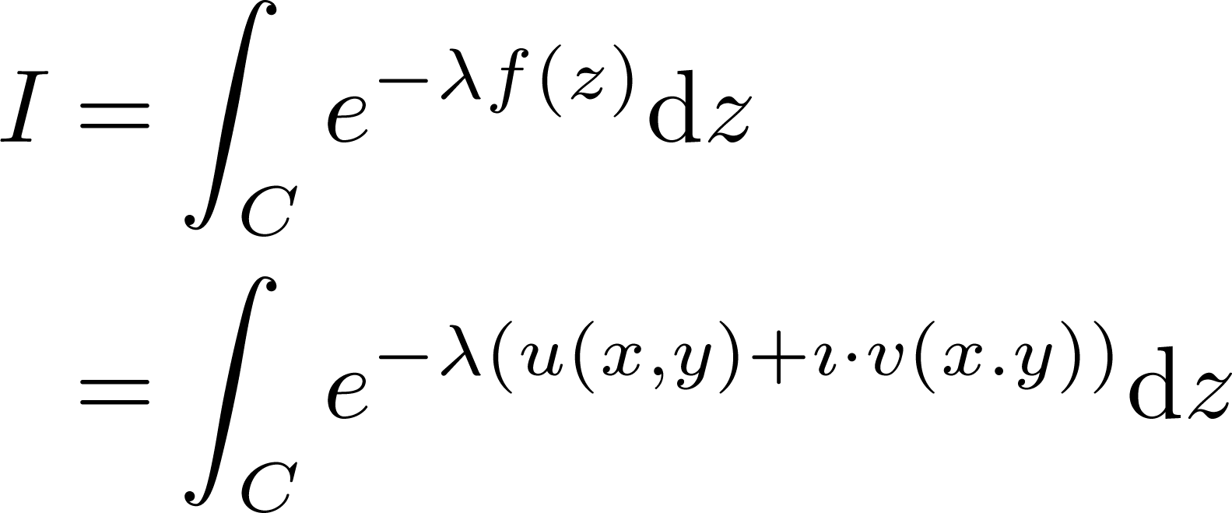
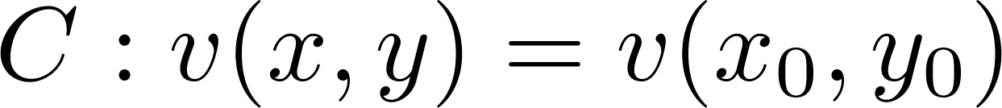
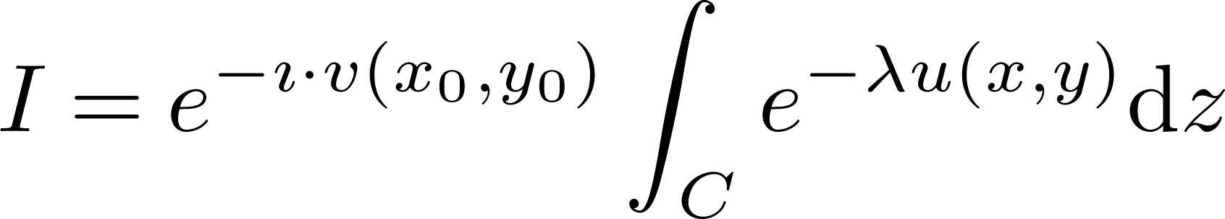
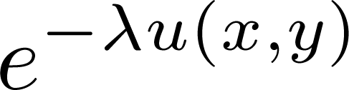
Contour integration (ctd):
consider:
if
observations:
  integrand is stationary/constant - phase along C
  C: the steepest descent contour for magnitude
C: suitable for numerical integration, at high accuracy

Slide 8
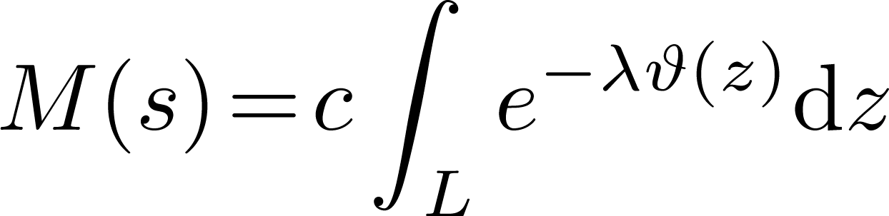
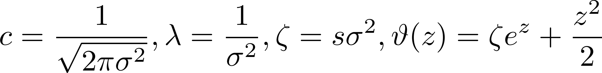
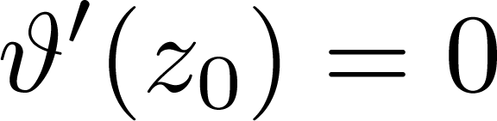
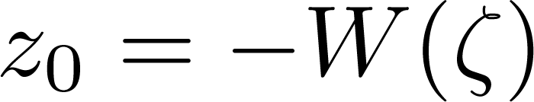
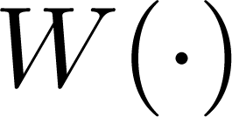
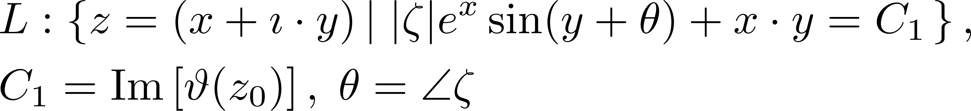
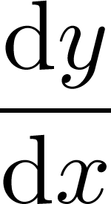
Computation of the MGF:
where
  saddle point given by
  where: Lambert W function
  steepest-descent, constant-phase contour
  derivative computable in closed-form

Slide 9

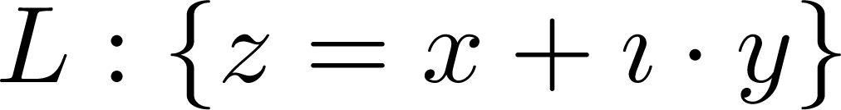
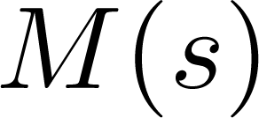
Computation of the MGF (ctd):
  steepest-descent, constant-phase contours
  for computing

Slide 10
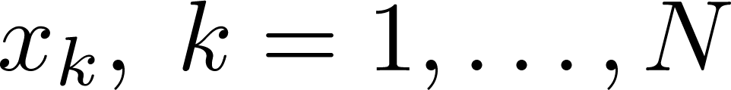

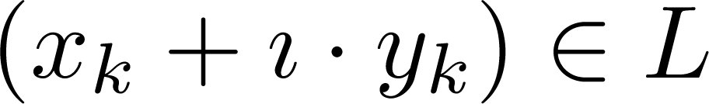

Computation of the MGF (ctd):
numerical evaluation (with suitable truncation) :
  N-point ‘mid-point’ rule on ‘x’, with step size h
  compute
  for points
  numerically compute such that
  - alternative: closed-form approximations to
  evaluate the integral as a sum

Slide 11
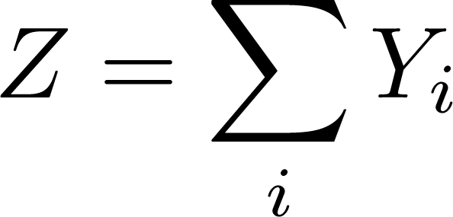
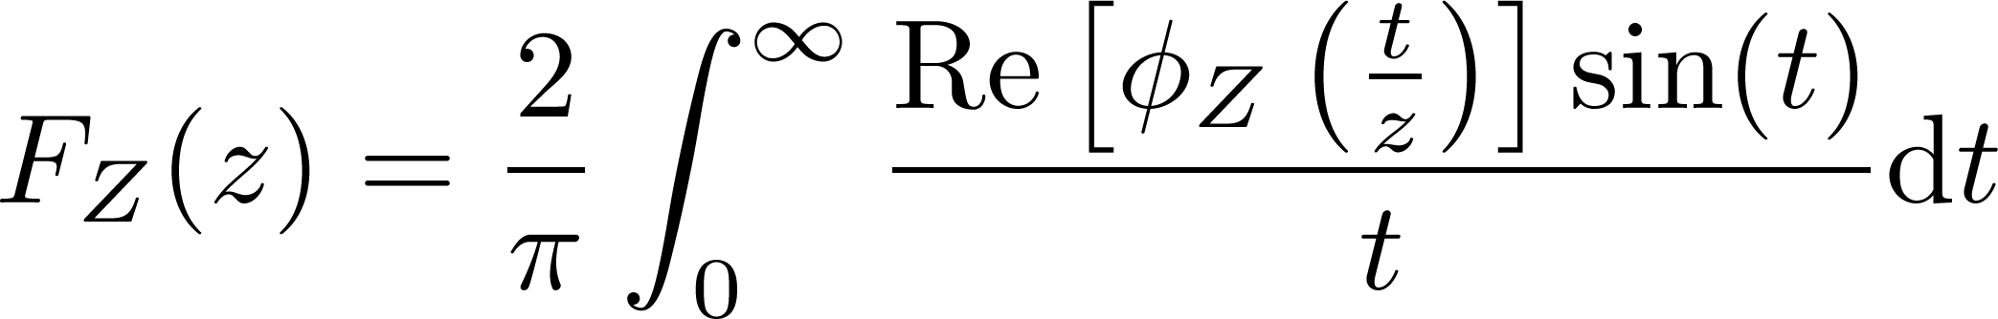
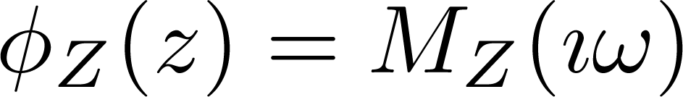
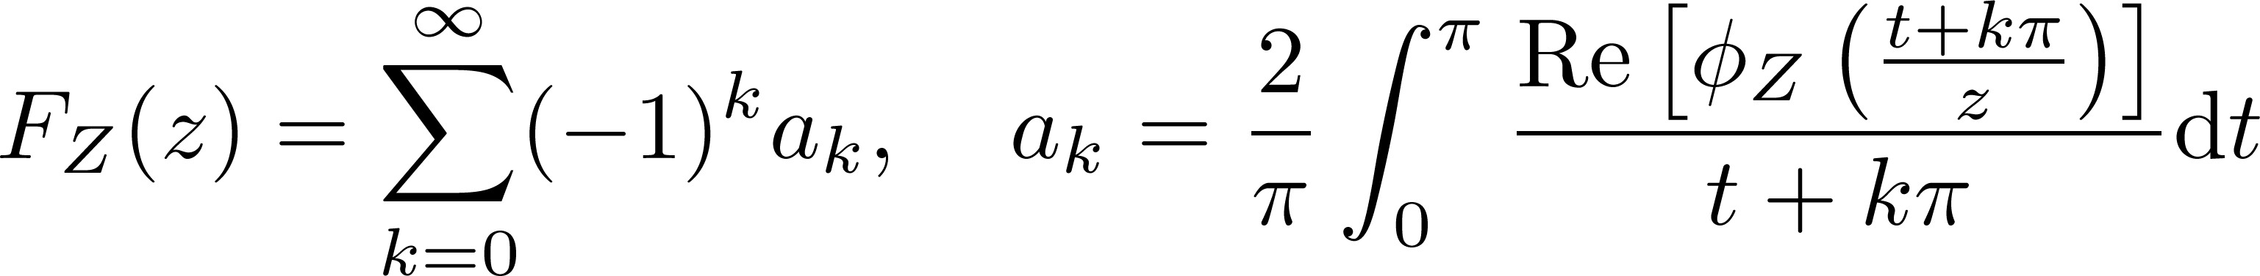

Log-normal sum CDF:
Sum of uncorrelated lognormal RVs
For positive RV, CDF:
where is the characteristic function.
Using [Longman1960]
  As an infinite series of smooth, finite integrals
  Breaking the range of integration at zeros of the integrand
    Integrand not oscillatory in
    evaluate with a simple quadrature rule

Slide 12
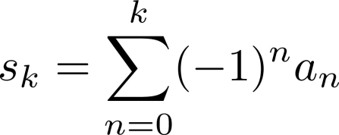
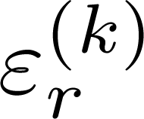
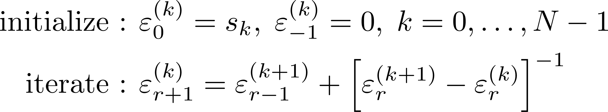

Lognormal sum CDF (ctd):
Use Epsilon algorithm for convergence acceleration [Wynn1956]
  Partial sums
  Populate the Epsilon array
    Row index: k
    Column index: r
    When N is odd, converged results in even columns
      Last column , will have estimate of

Slide 13
Numerical results:
6 i.i.d. Lognormal random variables
(mean 0dB, standard deviation 6 dB)
(on lognormal paper)

Slide 14
Numerical results:
6 i.i.d. Lognormal random variables
(mean 0dB, standard deviation 6 dB)

Slide 15
Numerical results:
6 i.i.d. Lognormal random variables
(mean 0dB, standard deviation 6 dB)

Slide 16
Numerical results:
6 i.i.d. Lognormal random variables
(mean 0dB, standard deviation 6 dB)

Slide 17
Numerical results:
6 i.i.d. Lognormal random variables
(mean 0dB, standard deviation 6 dB)

Slide 18
Conclusion:
Presented work attempts numerical evaluation of:
  Lognormal MGF/ CHF; using contour integration
    e.g. 64 point mid-point rule, on steepest descent contour
  Lognormal sum CDF; using [Longman1960] and convergence acceleration [Wynn1956]
    e.g. 10-25 terms, evaluated using ‘quadl’ (about 30s, for 13 digit accuracy)
Numerical evaluation of Lognormal sum distribution
even at very high precision is feasible
Can be used with other distributions, to evaluate outage

Slide 19
References:
[Limpert2001] E. Limpert, W. A. Stahel, and M. Abbt, “Log-normal distributions across the sciences: keys and clues,” BioScience, vol. 51, no. 5, pp. 341–352, May 2001.
[Longman1960] I. M. Longman, “A method for the numerical evaluation of finite integrals of oscillatory functions,” Math. Comput., vol. 14, pp. 53–59, 1960.
[Wynn1956] P. Wynn, “On a device for computing the em(Sn) transformation,” Math. Tables Aids Comput., vol. 10, pp. 91–96, 1956.
[Fenton1960] L. Fenton, “The sum of log-normal probability distributions in scatter transmission systems,” IRE Transactions on Communications Systems, vol. 8, no. 1, pp. 57–67, Mar. 1960
[Schwartz1982] S. C. Schwartz and Y. S. Yeh, “On the distribution function and moments of power sums with log-normal components,” Bell Systems Technical Journal, vol. 61, no. 7, pp. 1441–1462, 1982.
[BeaulieuRajwani2004] N. Beaulieu and F. Rajwani, “Highly accurate simple closed-form approximations to lognormal sum distributions and densities,” IEEE Commun. Lett., vol. 8, no. 12, pp. 709–711, Dec. 2004.
[BeaulieuXie2004] N. C. Beaulieu and Q. Xie, “An optimal lognormal approximation to lognormal sum distributions,” IEEE Trans. Veh. Technol., vol. 53, no. 2, pp. 479–489, Mar. 2004.

Slide 20
Thank You!

